Slide 1
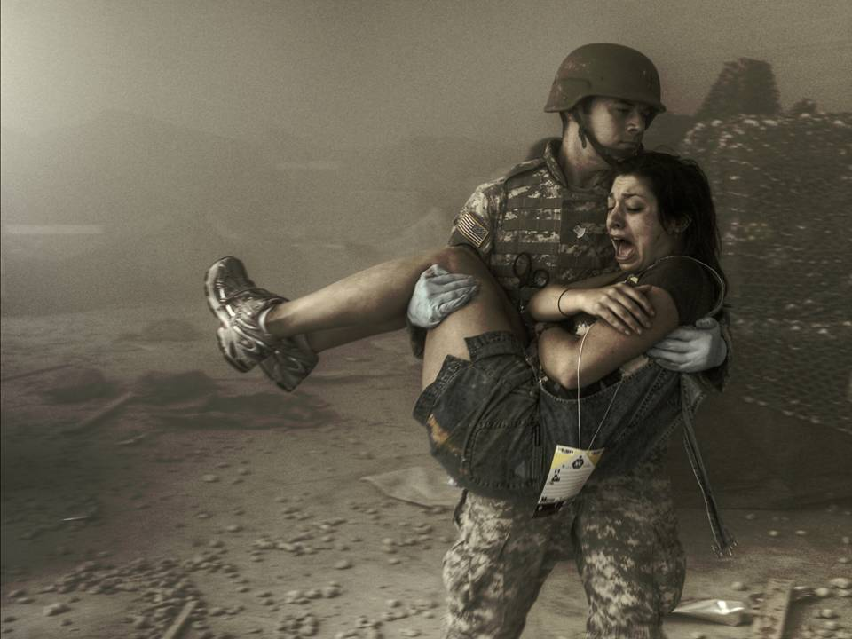
2023
Rush Advanced Trauma
Training Program
Continuing Education Hours:
ATTC awards up to 51 hours of CEUs.
ATTC-E awards up to 84.25 hours of CEUs.
85.25 hours CEUs in MODS.
IDTC awards up to 21 CEUs.
BHTC awards up to 14 CEUs.
Certification Courses awards additional CEUs.
Course Modules:
ATTC (various curriculums):
International Trauma Life Support (ITLS)
Basic Disaster Life Support (BDLS)
Combat Stressor Awareness/
Traumatic Brain Injury (TBI)
Cadaver Laboratory
Tissue Laboratory
Combat Trauma Lane/MASCAL
Exercise/Simulation Laboratory
Ambulance Ride-Along Experience
Level One Trauma Center Experience
ATTC-Expanded options adds (see schedule on back):
Tactical Combat Casualty Care (TCCC)
Tactical Emergency Casualty Care (TECC)
Advanced Burn Life Support (ABLS)
Basic Life Support (BLS)
Advanced Cardiac Life Support (ACLS)
Pediatric Advanced Life Support (PALS)
Advanced Trauma Life Support (ATLS)
Advanced HAZMAT Life Support (AHLS)
Trauma Nurse Core Course (TNCC)
Pre-Hospital Trauma Life Support (PHTLS)
Critical Care Emergency Medical Transport Program (CCEMT-P)
Infectious Disease Training Course (IDTC)
Behavioral Health Training Course (BHTC)
Ultrasound Training Course (USTC)

Slide 2
2023 Rush Advanced Trauma Training Program (ATTP)
Advanced Trauma Training Course (ATTC) and ATTC-Expanded
1-3 November 2022.
16-20 January (16-25 January ATTC-Expanded Curriculum); TCCC: 12, 13 January; Ultrasound Training: 25 January.
21-23 February (TCCC/Procedural Labs).
20-24 March; TCCC: 16, 17 March.
17-21 April; TCCC: 13, 14 April.
15-19 May; TCCC: 11, 12 May.
12-17 June; ABLS: 12 June; PHTLS: 14, 15, 16 June; Cadaver/Tissue Labs; TCCC: 16, 17 June.
24-28 July (24 July-1 August ATTC-Expanded Curriculum); TCCC: 20, 21 July.
21-25 August (21-30 August ATTC-Expanded Curriculum); TCCC: 17, 18 August; Ultrasound Training: 30 August.
18-22 September; TCCC: 14, 15 September; AHLS: 25, 26 September.
Additional Training:
Critical Care Course- Critical Care Emergency Medical Transport Program (CCEMT-P) and 240 clinical hours-TBD Infectious Disease Training Course (IDTC): 23-25 May; 11-13 July
TCCC-Combat Lifesaver – contact us to schedule your course.
For course details or registration information:
Dave Leckrone, Colonel, USA, Retired
Rush University ATTP Program Consultant
C- (217) 652-6368/ O-(217)-585-0225
david.leckrone@rushattp.com
https://www.rushattp.com
www.rushu.rush.edu/medical-trauma-training

