Slide 1
2015 Match
Rush University Medical Center
Department of Internal Medicine

Slide 2
Internal Medicine Class of
2018

Slide 3
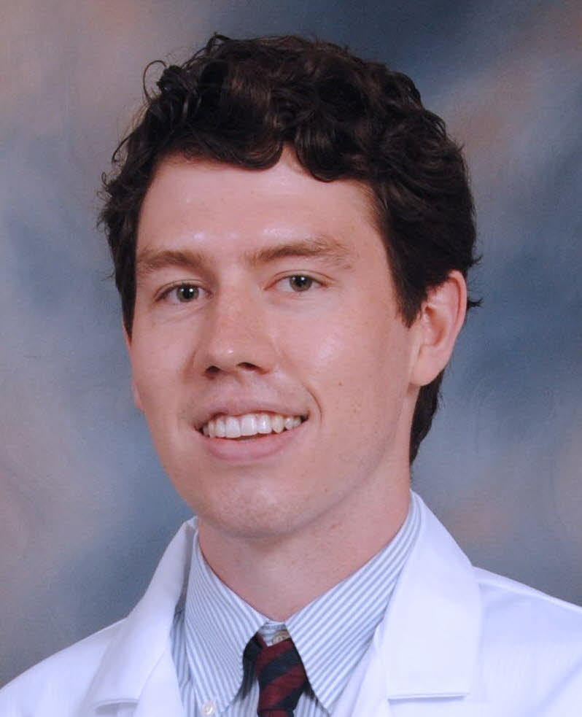
Michael Accavitti
Medical School:
Tulane University
Graduate School:
Vanderbilt University
Undergraduate School:
Vanderbilt University
Fun Fact:
I once made Jerry Seinfeld laugh.

Slide 4
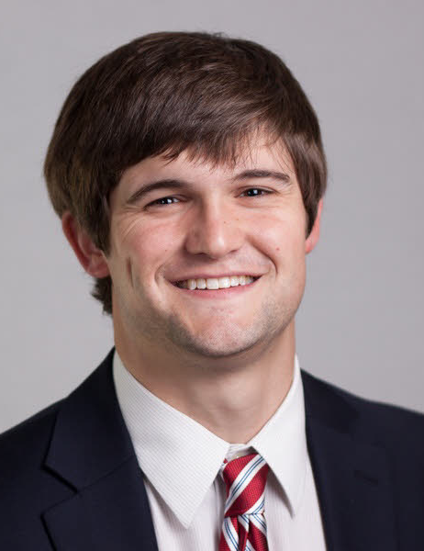
Will Barge
Medical School:
University of Tennessee
Undergraduate School:
Vanderbilt University
Fun Fact:
My grandfather was the first person to climb the highest mountain in all seven continents.

Slide 5
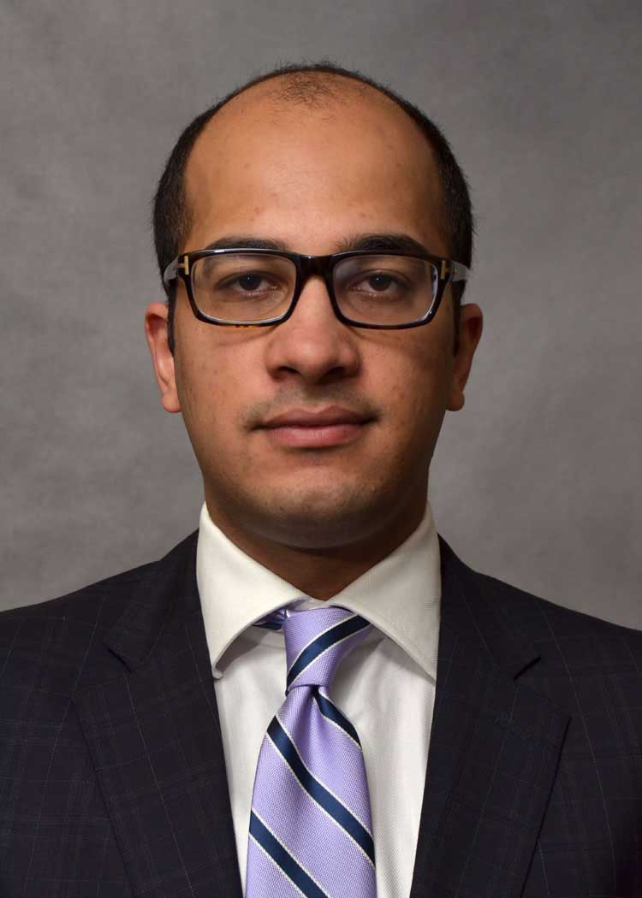
Usman Barlass
Medical School:
Aga Khan University, Karachi, Pakistan
Undergraduate School:
Aitchison College, Lahore, Pakistan
Fun Fact:
I love art and music.

Slide 6
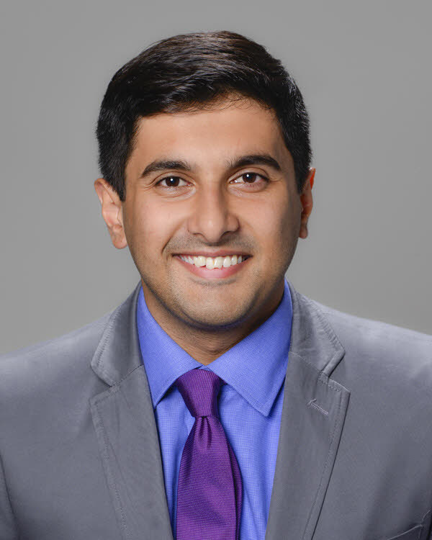
Parva Bhatt
Medical School:
University of South Florida
Undergraduate School:
New York University
Fun Fact:
I find it difficult to live without pizza.

Slide 7
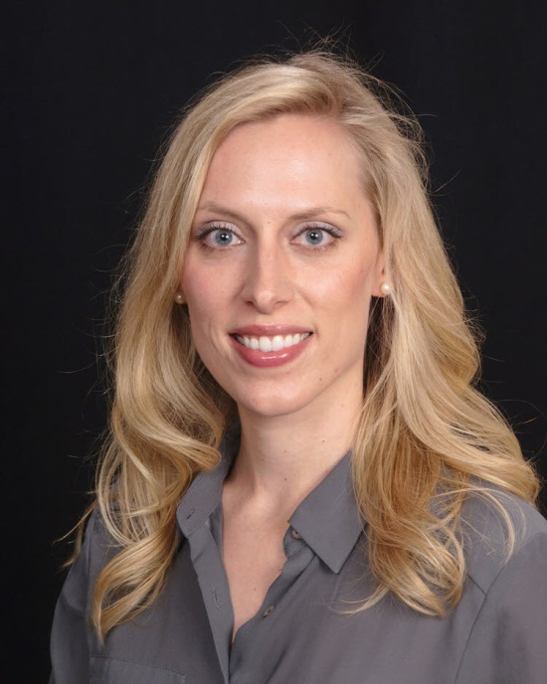
Jessie Bjorklund
Medical School:
Saint Louis University
Undergraduate School:
Drury University in Springfield, MO
Fun Fact:
I hope to one day completely fill all of the pages in my passport.

Slide 8
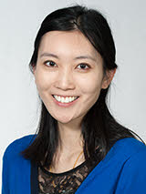
Kelsey Chow
Medical School:
Chicago Medical School
Undergraduate School:
University of Colorado at Boulder
Fun Fact:
I am left-handed, and the majority of my family (my mom, sister, and myself) is also left-handed.

Slide 9

Michael Lawrenz Co
Medical School:
University of the Philippines
Undergraduate School:
University of the Philippines
Fun Fact:
I am an avid tennis player (who uses two forehands) and stock trader (who uses candlesticks).

Slide 10
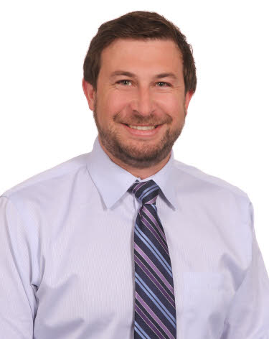
Jimmy Coggan
Medical School:
Chicago College of Osteopathic Medicine
Undergraduate School:
Seattle Pacific University
Fun Fact:
I’ve been lucky enough to see soccer games in 19 different cities, 7 different countries, and 3 different continents.

Slide 11
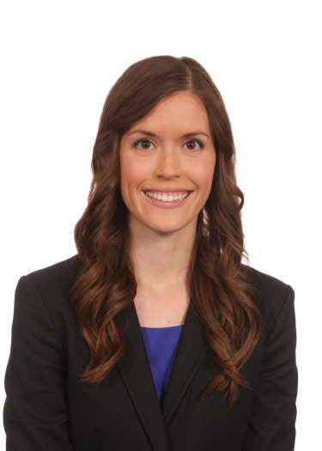
Liz Elliott
Medical School:
Chicago College of Osteopathic Medicine
Undergraduate School:
University of Wisconsin
Fun Fact:
I am an undefeated limbo champion.

Slide 12
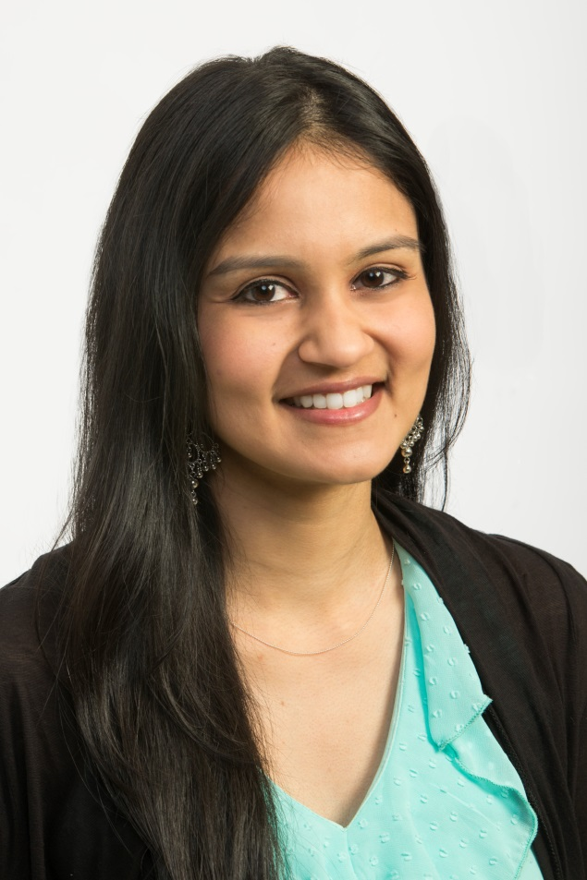
Anu Gampa
Medical School:
Rush Medical College
Undergraduate School:
University of Illinois at Chicago
Fun Fact:
I have been an active dance company member of Natya Dance Theatre (an Indian classical dance company in Chicago - www.natya.com) since 2008. Everyone is welcome to our future performances in the city!

Slide 13
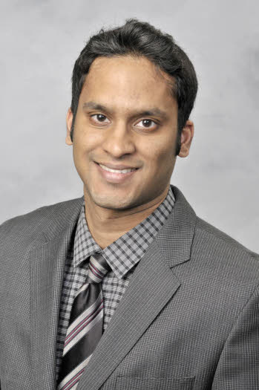
Nitin Garg
Medical School:
University of Illinois
Undergraduate School:
University of Illinois at Chicago
Fun Fact:
I was born on India’s Independence Day!

Slide 14
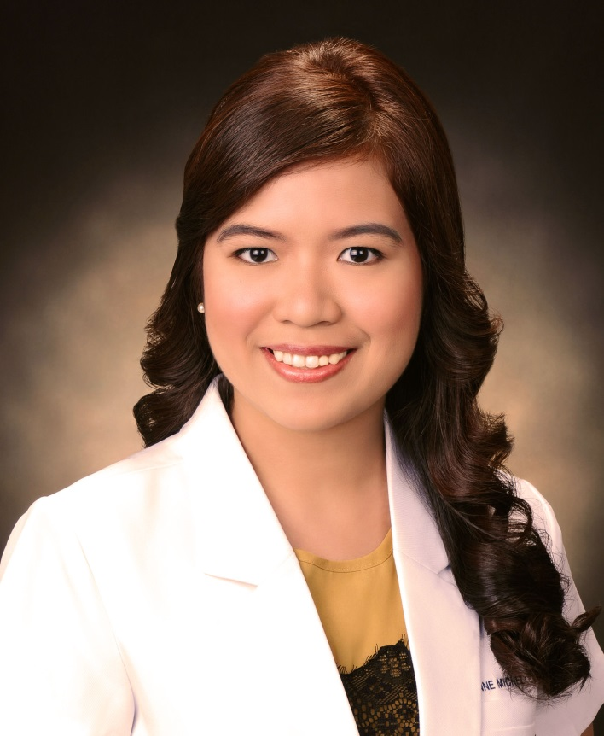
Joanne Michelle Gomez
Medical School:
University of the Philippines
Undergraduate School:
University of the Philippines
Fun Fact:
I was pop-singing school trained at age 10.

Slide 15

Sam Goodman
Medical School:
Chicago Medical School
Undergraduate School:
University of Michigan
Fun Fact:
“I have the coolest girlfriend in the world – she even does my homework for me!” (written by Sam’s girlfriend)

Slide 16
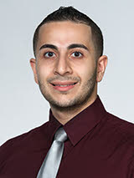
Thayer Hamoudah
Medical School:
Chicago Medical School
Undergraduate School:
Loyola University Chicago
Fun Fact:
I’ve been white water rafting in the Nile River.

Slide 17
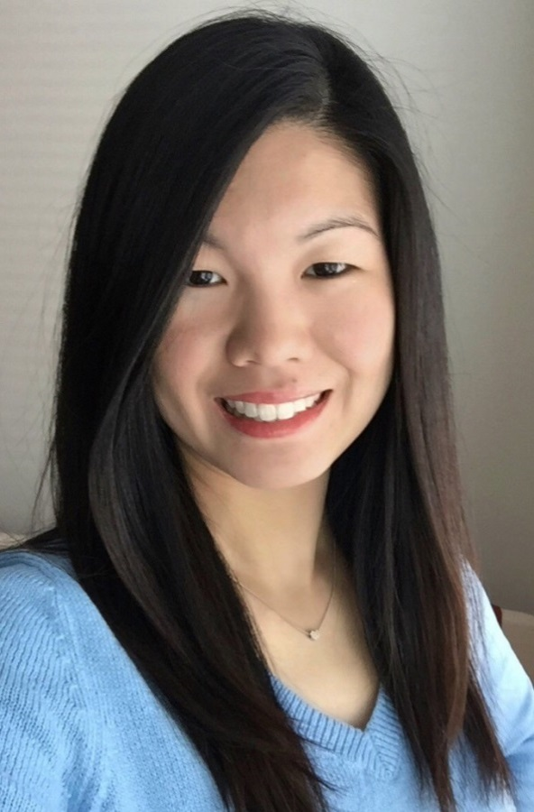
Connie Ho
Medical School:
Virginia Commonwealth University
Undergraduate School:
University of Illinois at Urbana-Champaign
Fun Fact:
I've been an extra twice for Showtime's Shameless, and also for two movies: Contagion and The Dilemma (the latter in which I accidentally brushed Channing Tatum's shoulder and stood only a few feet from Vince Vaughn)!

Slide 18
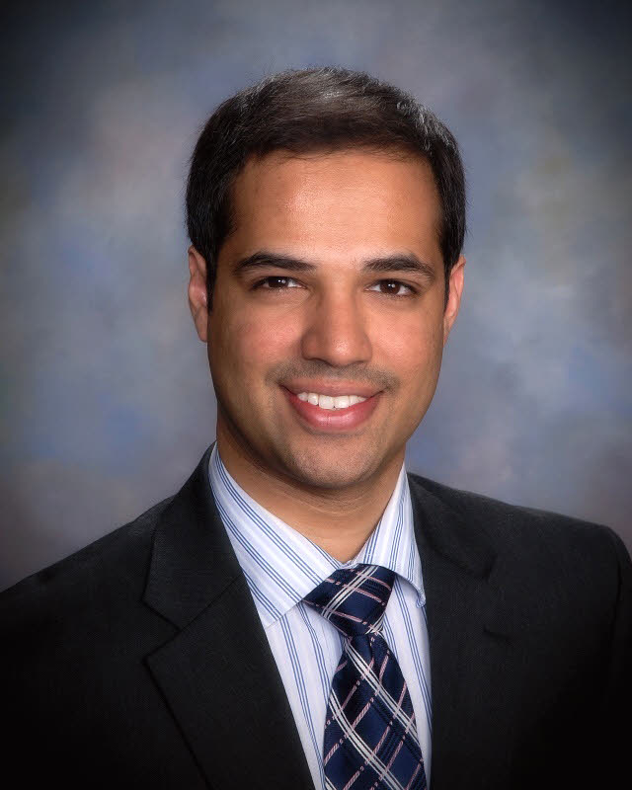
Aditya Jain
Medical School:
New York Medical College
Undergraduate School:
University of Michigan
Fun Fact:
I have lived in five different countries – Saudi Arabia, India, England, Wales, and the United States.

Slide 19
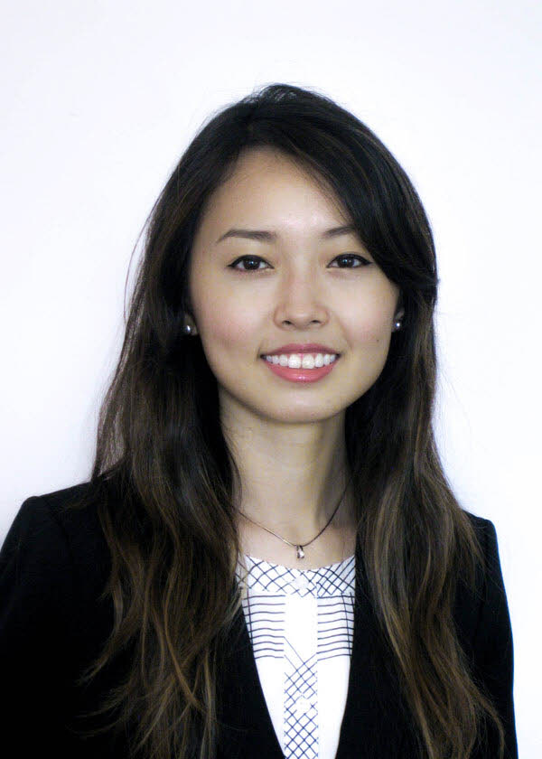
Diane Ma
Medical School:
Saint Louis University
Undergraduate School:
Washington University in St. Louis
Fun Fact:
I enjoy playing tennis and dancing.

Slide 20
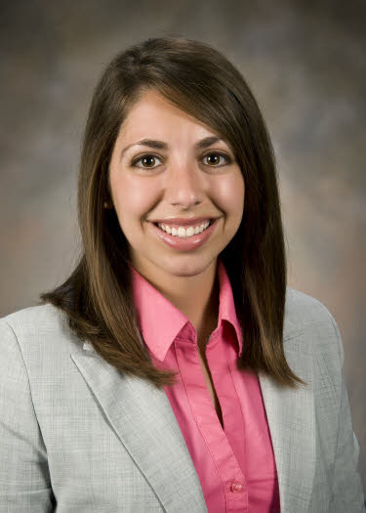
Jayne Miely
Medical School:
Wright State University
Undergraduate School:
Wittenberg University
Fun Fact:
I grew up in Columbus (go Bucks!) and went to both undergrad and med school within an hour of home. I am beyond excited to be living outside of Ohio for the first time and to experience a new city!

Slide 21
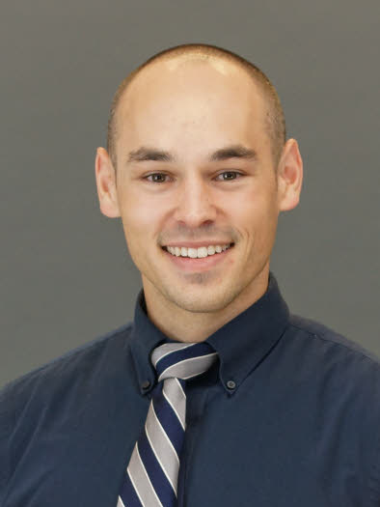
Alex Moseley
Medical School:
The Ohio State University
Undergraduate School:
University of Toledo
Fun Fact:
In the third grade I made a girl laugh so hard she threw up on me.

Slide 22
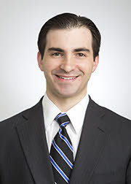
Brent Nathan
Medical School:
Rush Medical College
Undergraduate School:
Lawrence University of Wisconsin
Fun Fact:
My birthday is April 1st/April Fool's Day. For the first few hours after I was born, all of my relatives thought my parents were pranking them. I occasionally get gag gifts such as a nested, progressively smaller boxes, each wrapped, with a present all of the way on the inside.

Slide 23
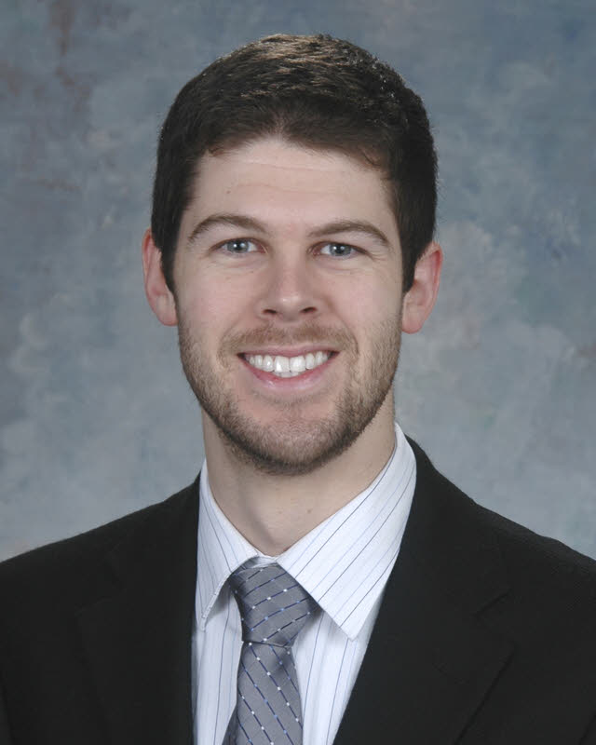
Patrick Onkka
Medical School:
Indiana University
Undergraduate School:
Indiana University
Fun Fact:
I can lick my elbows.

Slide 24
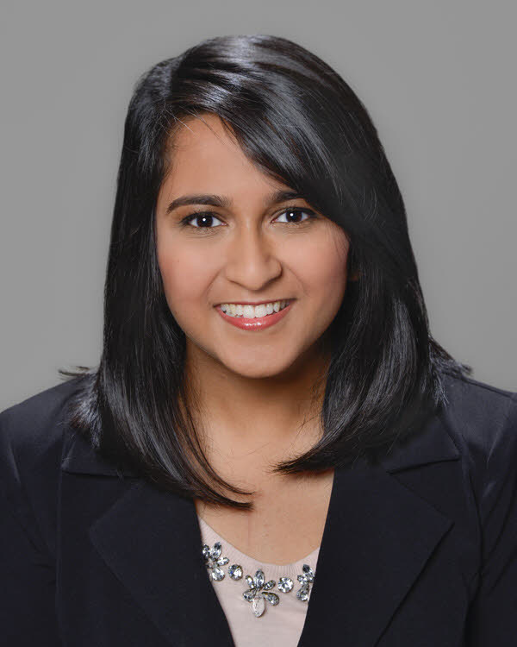
Tara Orekondy
Medical School:
University of South Florida
Undergraduate School:
University of Florida
Fun Fact:
Brunching is my favorite activity!

Slide 25
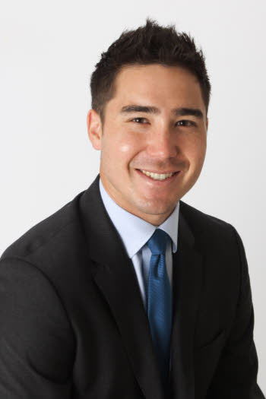
Brent Ozaki
Medical School:
George Washington University
Graduate School:
Trinity College Dublin
Undergraduate School:
University of Southern California
Fun Fact:
I grew up in San Diego. I played competitive ice hockey for years, but I can't surf.

Slide 26
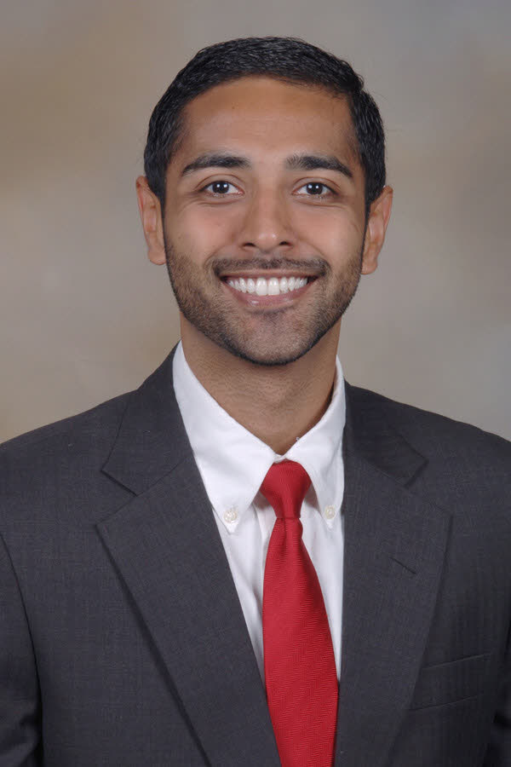
Akshar Patel
Medical School:
Louisiana State University
Undergraduate School:
Tulane University
Fun Fact:
I love to travel - I'm currently in an airport in Mexico on my way to spend 2 weeks trekking in Patagonia.

Slide 27
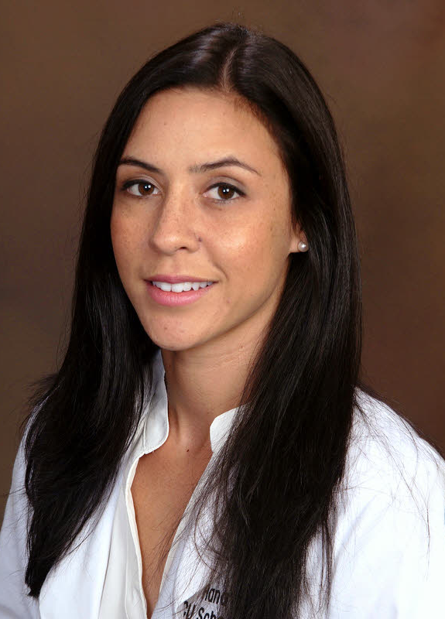
Hana Poser
Medical School:
Virginia Commonwealth University
Undergraduate School:
Carroll University
Fun Fact:
I once met Johnny Depp at my grandmother’s house.

Slide 28
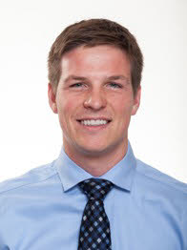
Tom Quinn
Medical School:
Rush Medical College
Undergraduate School:
University of Illinois at Urbana-Champaign
Fun Fact:
I speak Lithuanian fluently.

Slide 29
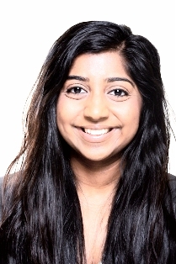
Priya Rajakumar
Medical School:
Rush Medical College
Undergraduate School:
Northwestern University
Fun Fact:
I am allergic to nuts, seafood, chickpeas, and the skin of apples!

Slide 30
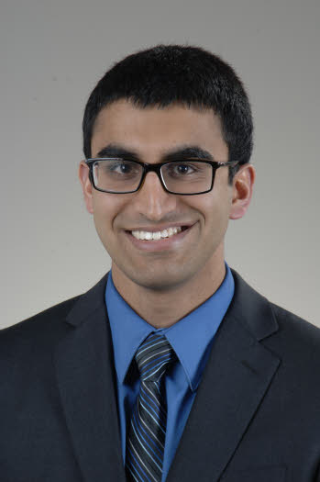
Nischal Raya
Medical School:
University of Toledo
Undergraduate School:
The Ohio State University
Fun Fact:
I was born in England and have traveled to 15 countries!

Slide 31
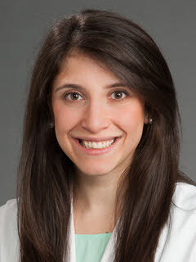
Candice Schwartz
Medical School:
Wake Forest School of Medicine
Undergraduate School:
Brandeis University
Fun Fact:
I lived in three countries growing up.

Slide 32
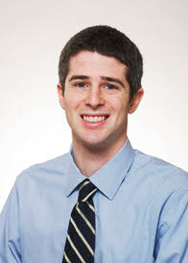
Charlie Schwartz
Medical School:
Rush Medical College
Undergraduate School:
University of Illinois at Urbana-Champaign
Fun Fact:
I was obsessed with Michael Jordan as a kid (and still kind of am) and have a collection of ~1000 MJ basketball cards

Slide 33
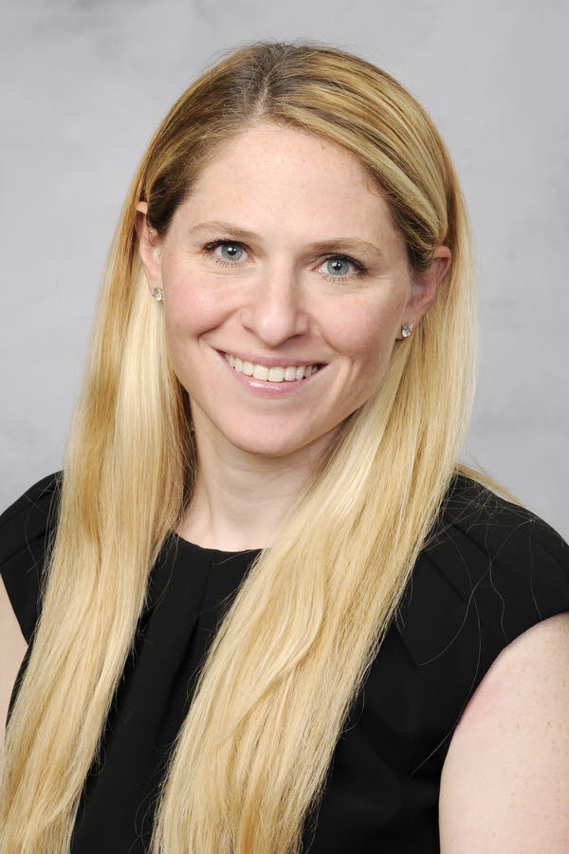
Alexandra Small
Medical School:
University of Illinois
Undergraduate School:
University of Pennsylvania
Fun Fact:
I was born at Rush, and so were my two siblings and all three of my children, ages 7, 5 and 1.

Slide 34
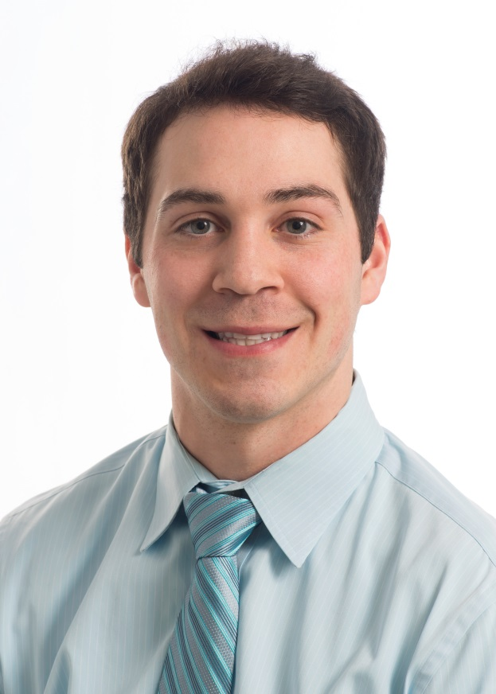
Frank Tenuto
Medical School:
Rush Medical College
Undergraduate School:
University of Illinois at Urbana-Champaign
Fun Fact:
I have tried every item on Taco Bell’s menu.

Slide 35
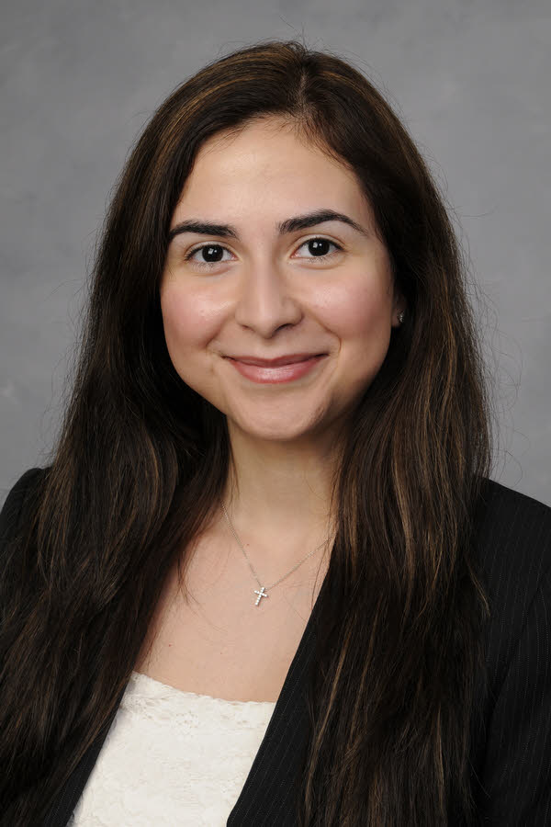
Denise Valero
Medical School:
University of Illinois at Chicago
Undergraduate School:
The University of Chicago
Fun Fact:
I enjoy taking Latin dance classes.

Slide 36
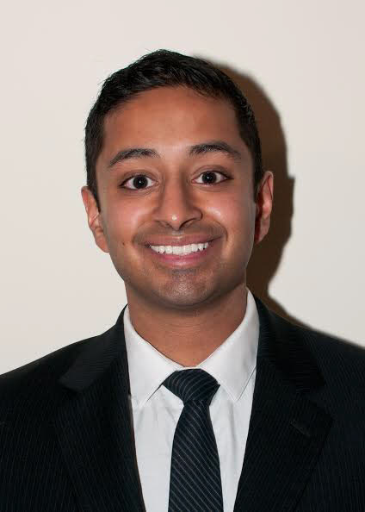
Krishnan Warrior
Medical School:
Rush Medical College
Undergraduate School:
University of Illinois at Urbana-Champaign
Fun Fact:
JK Rowling told me that I look like Harry Potter when I was a kid.

Slide 37
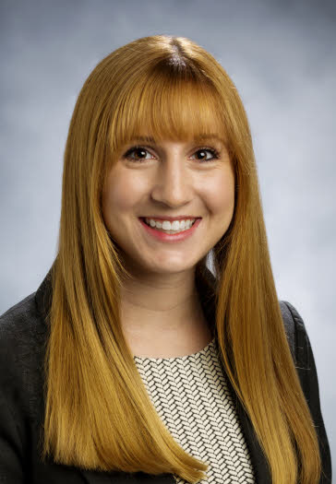
Katie Welter
Medical School:
Southern Illinois University
Undergraduate School:
University of Illinois
Fun Fact:
I was a cheerleader for the Fighting Illini. ILL-INI!

