Slide 1
ID Ground Rounds Case Presentation

Slide 2
History of Present Illness (HPI)
Chief Complaint:
Right hip pain and associated chills
56 year old female with no significant past medical history
Pain in the right lateral hip started 9 months ago after participating in the Special Olympics Polar Plunge
Had been receiving periodic steroid injections by primary care physician (PCP) for suspected bursitis

Slide 3
HPI
Steroid injections would provide relief for 5-6 weeks, and then pain would return
Had a total of 3 steroid injections over the past 9 months1 month ago he noticed increasing swelling over R lateral hip, but no increase in pain
Pain was worse with certain positions (noticed most when she was sleeping or walking)
ROS: Denied fevers, nausea, vomiting; endorsed intermittent chills for several days
Called her PCP who advised to go to emergency department for further evaluation

Slide 4
Past Medical History: None
Past Surgical History: Cesarean section
Social History: Born and raised in Europe, grew up on a farm. Works as a paralegal. Lives at home with husband. Former smoker. Social drinker. Denies any illicit drug use. No pets at home.
Family History: Rheumatoid arthritis (father)
Meds: Celebrex
Allergies: Morphine (hives)

Slide 5
Physical Exam
VITAL SIGNS: BP 150/84, HR 81, Temp 98.1, RR 18, SpO2 100%
GENERAL: alert and oriented, well-appearing, age-appropriate in no apparent distress
NECK: no cervical lymphadenopathy
LUNGS: CTAB, no wheezes/rales/rhonchi, breathing unlabored
CVS: Regular rate and rhythm, normal S1S2, no murmurs/rubs/gallops, 2+ dorsalis pedis pulses bilaterally
ABD: soft, non-tender, nondistended, normoactive bowel sounds
BACK: no deformity, no tenderness with palpation
EXTREMITIES: A fluid filled mass (2-3cm) in the posterior buttock area with overlying area of erythema. There is fluctuance and focal tenderness to palpation and she does have palpable fluid wave that extends down to her mid thigh and posteriorly into the buttock. Pain with abduction against gravity. Pain with maximum internal rotation and flexion.

Slide 6
Laboratory Results
CMP:
Lab Results
NA 139
K 4.3
CL 104
CO2 22
BUN 13
CREAT 0.72
GLU 85
PROT 8.0
ALB 3.4
CA 8.3
TBIL 0.5
AP 138
SGOT 32
SGPT 18
CBC:
Lab Results ESR 47, CRP 142
WBC 9.7
RBC 3.9
HGB 11.5
HCT 34.2
MCV 85.7
RDW 13.2
PLT 311

Slide 7
X-ray lateral right hip:
Cortical irregularity of the greater trochanter of right femur with increased surrounding soft tissue thickening, concerning for possible osteomyelitis.

Slide 8
MRI Right Hip
Multiple fluid collections are noted at the right hip region surrounding the right greater trochanter, as well as overlying the superficial fascia of the right proximal thigh and within the right gluteal soft tissues.
Cortical erosions/cortical bone loss at the region of the greater trochanter with underlying intramedullary radiolucent changes, which suggest involucrum

Slide 9
Hospital Course
Orthopedic Surgery took to the operating room (OR) for incision and drainage of R gluteal abscess
Immediate release of 500 ml purulent fluid from a cavity that extended to gluteal musculature
Cavity probed with connection to greater trochanteric bursa, which also continued purulent fluid
Probed through greater trochanteric bursa to bone
Bone was not soft/necrotic, no bone debrided. OR cultures sent at that time.

Slide 10
OR Specimen
Deep Right Hip Tissue
Gram Stain
Moderate red blood cells
Few white blood cells
No organisms seen
No Acid Fast Bacilli seen

Slide 11
Thoughts?

Slide 12
Hospital Course, continued
Cultures with no growth during admission
Treated with IV vancomycin and PO levofloxacin 750 mg daily
Pain, swelling, redness of R hip improved after I&D, antibiotics
PICC placed and patient discharged to home to complete 6 weeks of antibiotic therapy

Slide 13
4 week follow up in ID clinic
Hip wound continues to drain, now more serous fluid
New growth from OR specimen
Deep Right Hip Tissue
Growth of Mycobacterium tuberculosis complex
Started on RIPE (Rifampin + Isoniazid + Pyrazinamide + Ethambutol + pyridoxine) therapy for tuberculous (TB) osteomyelitis with bursitis and gluteal abscess of right hip

Slide 14
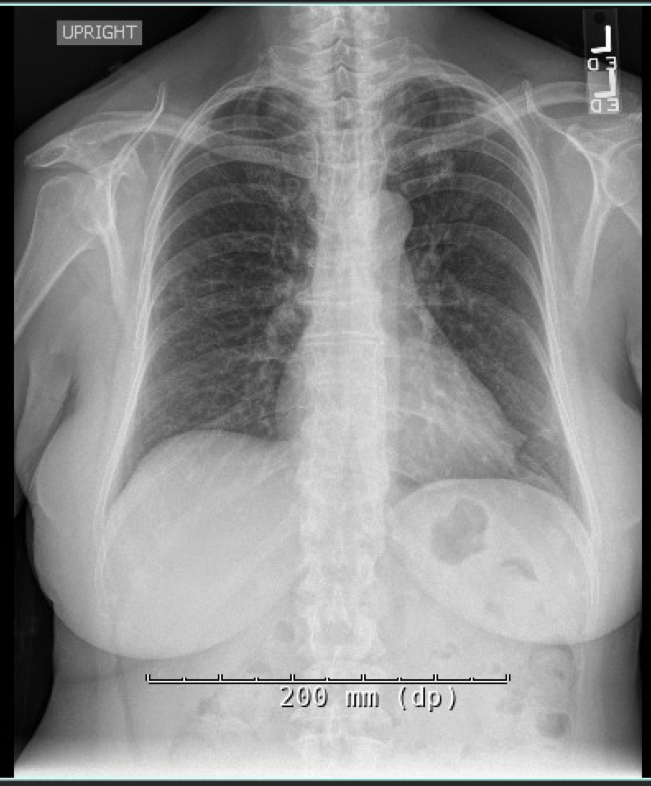
Chest X-ray:
1. No focal consolidation.
2. Small nodular opacity within the apex of the right lung. Two additional smaller nodules within the lateral right middle lobe and along the lateral aspect of the left lung base.

Slide 15
10 days into therapy…
Patient calls complaining of nausea, vomiting, fatigue, poor oral intake, frequent belching
Admitted directly from clinic due to suspected intolerance of TB medications

Slide 16
New Laboratory Results
CBC:
Lab Results
WBC 7.3
HGB 14
HCT 42.4
PLT 314
CMP:
Lab Results
NA 139
K 4.4
CL 102
CO2 16
BUN 20
CREAT 0.84
GLU 74
PROT 8.0
ALB 3.7
CA 8.3
TBIL 1.7 (upper limit normal: 0.4)
AP 290 (upper limit normal: 164)
AST 1287 (upper limit normal: 46)
ALT 532 (upper limit normal: 33)

Slide 17
Chest CT scan without IV contrast
Upper lobe predominant pulmonary nodules, one of which is cavitary.
Constellation of findings is most suggestive of post primary tuberculosis in accordance with provided clinical history.

Slide 18
Hospital Course
All TB medications held
Improvement in liver function levels and gastrointestinal/constitutional symptoms
AFB sputum smear negative x 3
Patient discharged to home with close infectious diseases follow-up and eventual step-wise re-introduction of TB medications

