Slide 1
ID Grand Rounds Case Presentation

Slide 2
History of Present Illness
34 year old man history of nephrolithiasis.
Presenting with 5-6 months of right eye pain and 2 months of mild, progressive blurred vision.
5 months ago, an outside ophthalmologist did “a few blood tests”, then prescribed Durezol eye drops (a topical corticosteroid), the pain resolved.
A month or two later, his pain recurred, and since has never really gone away.

Slide 3
History of Present Illness
Thereafter managed intermittently with topical and then systemic steroids, currently 60 mg prednisone daily.
More recently, his right eye pain has been increasing and has developed a clear discharge with eye redness.
ROS: Cut on his right calf which has not fully healed; otherwise he felt completely healthy. No fevers, chills, weight loss, night sweats, malaise, fatigue, sick contacts, cough, diarrhea, joint pains. No symptoms in the left eye.

Slide 4
Social History
Intermittently sexually active with one partner, last encounter was 6 months ago.
Lives in the suburbs. Recent kitchen renovation at home. Works at a job fixing computers.
Born in Southeast Asia, came to the Western United States (US) at a few months old. Moved to the Midwest when he was 10 years old. Lived in the Eastern US from ages 18 to 24 years old.
Last travel was to the Southwestern US 2 years ago.

Slide 5
Physical Exam
External Lids and Lashes: Normal.
Conjunctiva: 2+ Injection OD (right).
Sclera: White.
Cornea: Hazy OD (right).
Anterior Chamber: OD (right): thick fibrinous material.
Iris: Multiple nodules with neovascularization. Large white iris nodule at 11-12 o’clock.
Skin: Right anterior leg with discrete non-tender 2 cm crusted round plaque with circumferential violaceous raised border.

Slide 6
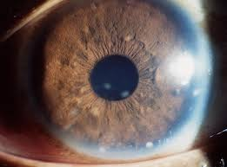
Representative Image. Not our patient.

Slide 7
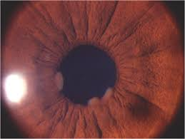
Representative Image. Not our patient.

Slide 8
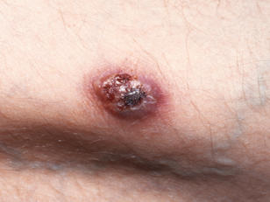
Representative Image. Not our patient.

Slide 9
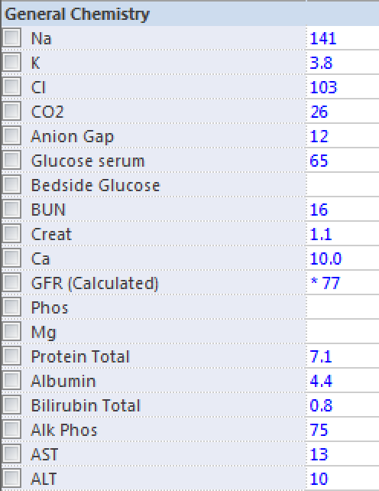
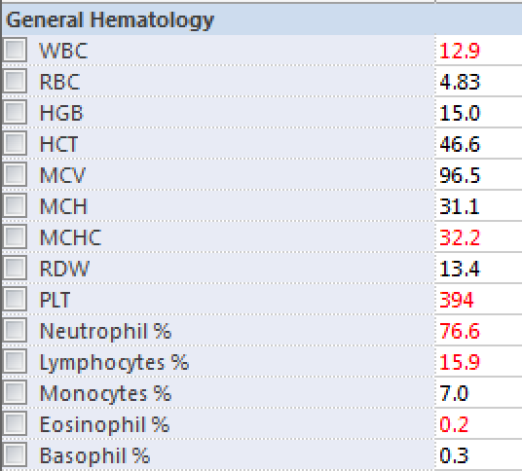
Initial Laboratory Results
ESR: 35 (Normal range: 0-18)
CRP: 2.24 (Normal range: 0-0.5)
ANA: Negative
HLA-B27: Positive

Slide 10
Initial Microbiology
Right eye exudate on 2 separate occasions: Moderate WBCs, no organisms seen, no growth.
Right leg biopsy: Normal skin flora. Acinetobacter (pan-S), MSSA (R-PCN, Clinda).
Right leg biopsy fungal culture: Smear negative. No growth.

Slide 11
Discussion

Slide 12
Skin Biopsy Pathology
Skin with pseudoepitheliomatous hyperplasia, spongiosis, acute and chronic inflammation, abscess formation, old hemorrhage, upper dermal edema, fibrosis and focally hair follicle associated and ill-defined granuloma containing multinucleated giant cells.
Note: There are scattered few much degenerated yeast forms of fungal elements seen with GMS stain. They are variable in size and internal architecture and cannot be further characterized due to significant degenerative change. Special stains of PAS, AFB, Fite, and Gram are negative.

Slide 13
Subconjunctival Tissue
Extensive granulomatous inflammation, majority of the inflammatory are macrophages.
GMS stain and, to a lesser degree, PAS stain highlight large budding yeast. These findings may be consistent with Blastomyces, Candida, Coccidiodes, or Histoplasma species, though culture results are necessary to provide a definitive answer.
Pancytokeratin (CKAE1/AE3), Mart-1, S-100, and SOX10 immunostains are negative. Gram and AFB stains are negative for other microorganisms. No evidence of malignancy.

Slide 14
Whole Body PET Scan
Hyper-metabolic activity in the right anterior globe. This may be consistent with inflammation in particular since recent biopsy performed in this area on 8/18/16. Nevertheless cannot entirely exclude neoplasm.
No evidence of FDG avid local or distant metastasis.

Slide 15
Hospital Course and Microbiology
Symptoms worsen and requires ocular decompression
Infectious Diseases is consulted; amphotericin B is started
Additional microbiologic work-up:
Quantiferon Gold: Negative
HIV Ag/Ab: Negative
Syphilis screen: Non-reactive
OR eye tissue from decompression: No growth on bacterial culture
Fungal blood culture: Negative
Serum Cryptococcus antigen: Negative
Urine Histoplasma and Blastomyces antigen: Negative

Slide 16
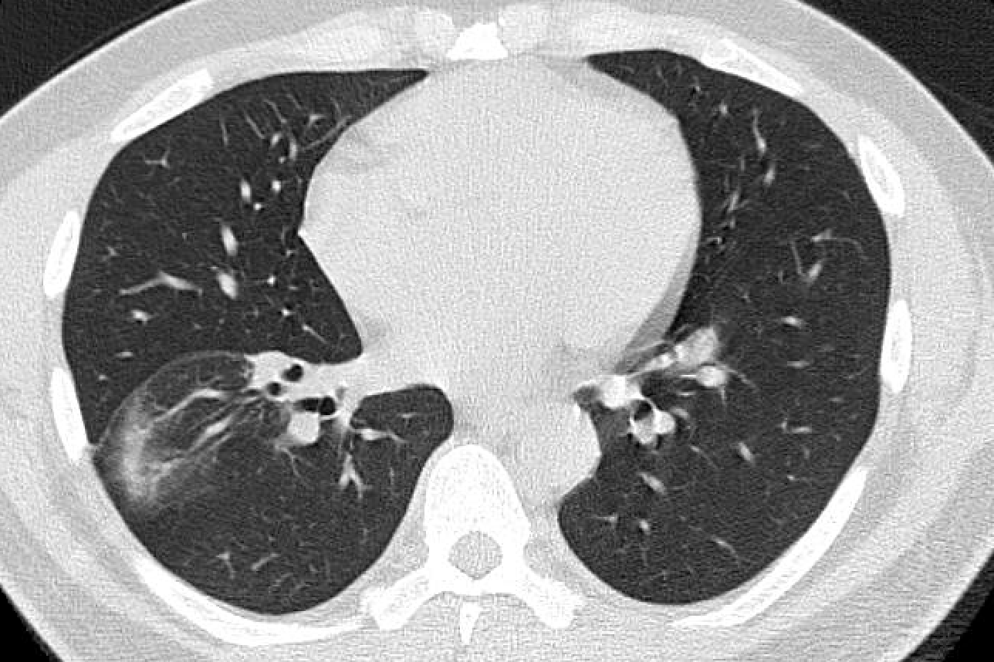
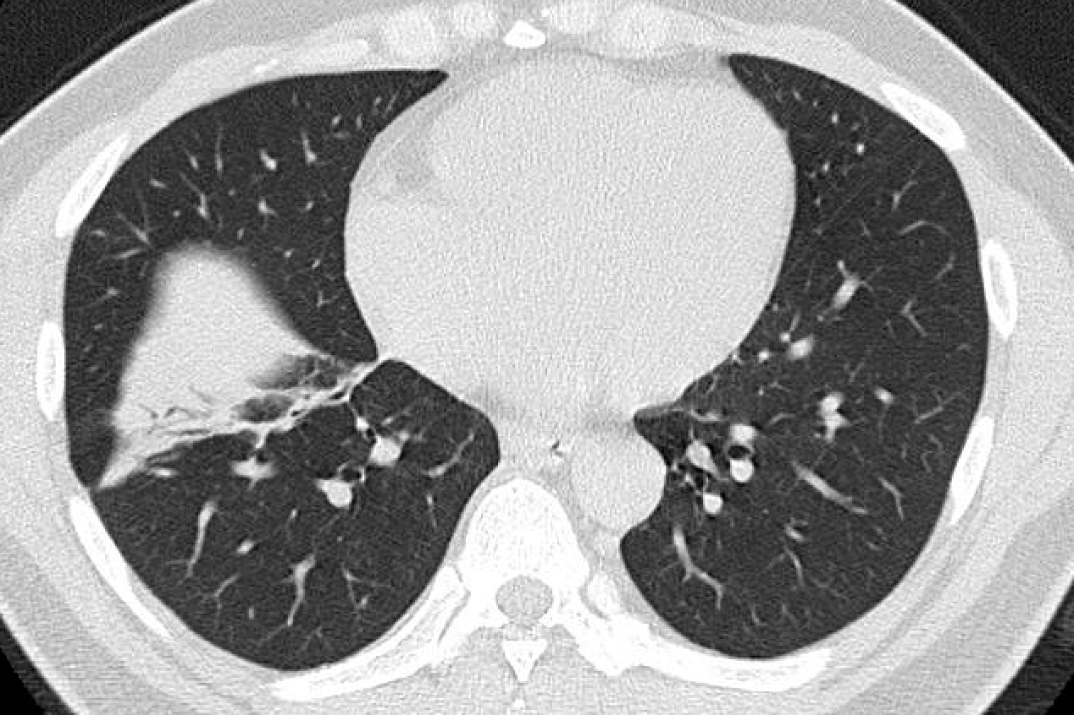
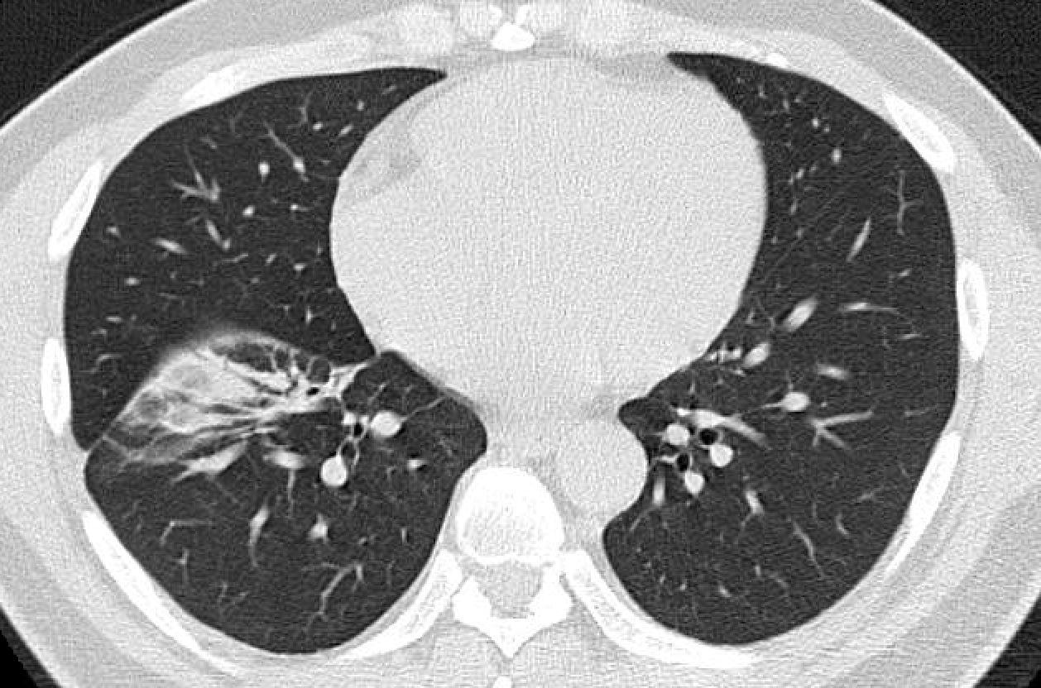
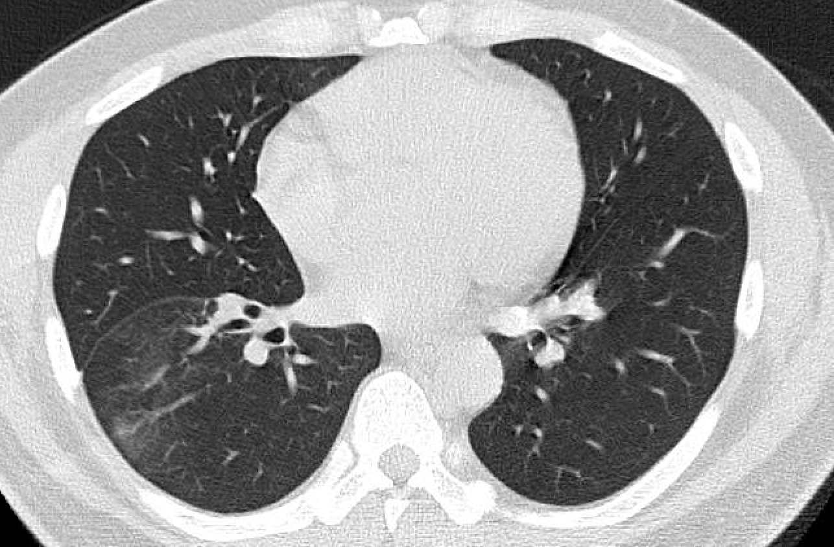

Slide 17
Hospital Course, continued
His eye pain progresses over 2 days.
His pain is uncontrolled with narcotics and other analgesics.
Now developing a severe headache.
Undergoes right eye enucleation and histopathology is obtained…

Slide 18
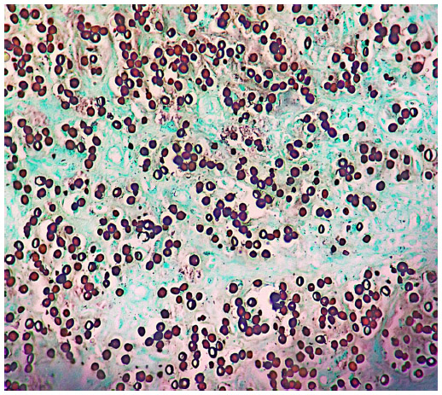
GMS Stain
Mucicarmine staining is negative.
Representative Image. Not our patient.

Slide 19
Enucleation Pathology
"Eye, right, enucleation”: Diffuse infiltration with budding yeast as well as abundant chronic granulomatous inflammation of the choroid, retina, vitreous, intraocular lens, iris, ciliary body, and anterior chamber.
PAS and GMS stains on the globe specimen are positive for large budding yeast. Gram stain is negative, as is mucicarmine. Though the organism cannot be definitively identified histopathologically, the size of the yeast, the presence of yeast budding, and the negative mucicarmine stains are suggestive of Blastomyces.

Slide 20
Diagnosis: Disseminated/Ocular Blastomycosis

