Slide 1
ID Grand Rounds Case Presentation

Slide 2
Emergency Department (ED)
Chief Complaint:
“Confusion for one day, hiccups for 3 days. States he felt unsteady on his feet earlier. Noted to have a history of cerebral aneurysm.”
Wife saw him leave for golf course in the morning and nothing abnormal was noted at that time.
Wife received a call from patient that he was lost.
Wife called police who found him over 1 hour away.
Patient arrived home and the wife noted him to be dazed, but otherwise was behaving appropriately.
Wife decided to bring him to ED as he seemed confused about leaving, but got into the car and came to ED.

Slide 3
ED
Past Medical History: Prostate cancer
Past Surgical History: Aneurysm clipping
Social History: Former smoker, lives with wife, retired
Meds: ASA, Rosuvastatin, Diazepam
ED vital signs: HR 82 T 99.1 RR 20 140/76 96% on Room Air
NIHSS 0
Exam: confusion; strength in 4 extremities and face 5/5 with intact light touch; no facial droop; no apraxia or aphasia
Review of Systems: Denied dizziness, ataxia, N/V, blurry vision
Code Stroke called

Slide 4
CT ED

Slide 5
Fever Curve

Slide 6
Thoughts?

Slide 7
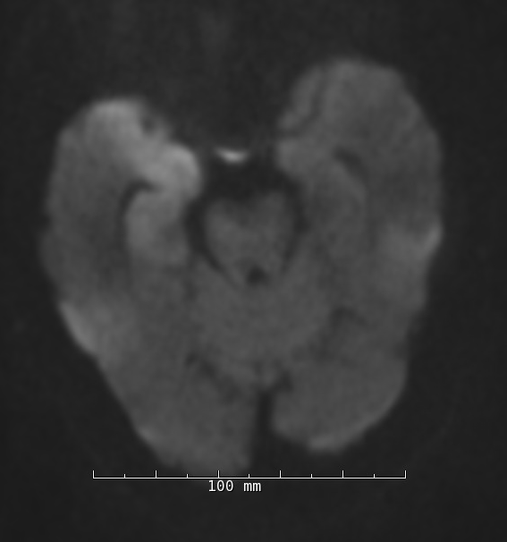
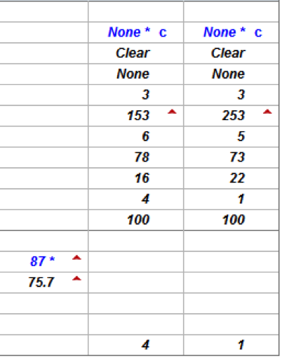
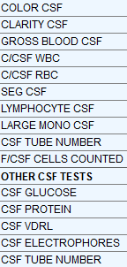
cEEG revealed generalized slowing, right temporal slowing, and right temporal PLEDs
Lumbar Puncture:

Slide 8
MRI Stroke
TECHNOLOGIST NOTE:
Confused, uncooperative patient moving excessively during the exam. Exam was aborted for patient's safety after he attempted to pull MRI equipment off. Best exam possible.
FINDINGS/ IMPRESISON:
Area of restricted diffusion involving the right hippocampus and medial aspect of the right temporal lobe. Other tiny focus of restricted diffusion in the medial aspect of the left thalamus. These findings may represent changes related postictal state, encephalitis, or potentially acute infarct. Repeat examination is recommended.

Slide 9
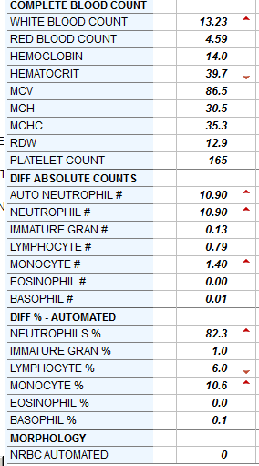
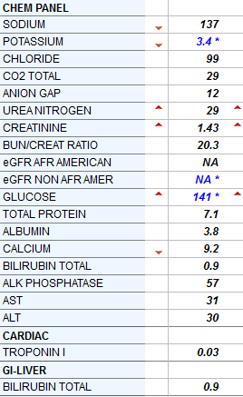
Cerebrospinal Fluid Studies: Hospital Day #1
From Lumbar Puncture:
Gram stain: moderate WBC, few RBC, no organisms
HSV1 PCR (-)
Obtained on Hospital Day #4
VZV PCR (-)
WNV PCR not detected
Serum: RPR, HIV (-)

Slide 10
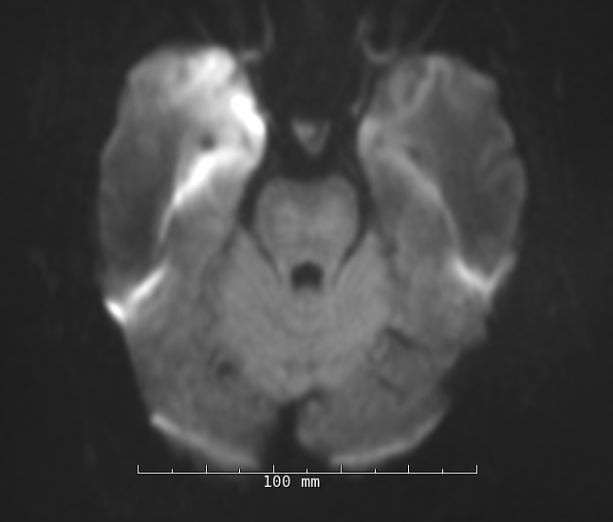
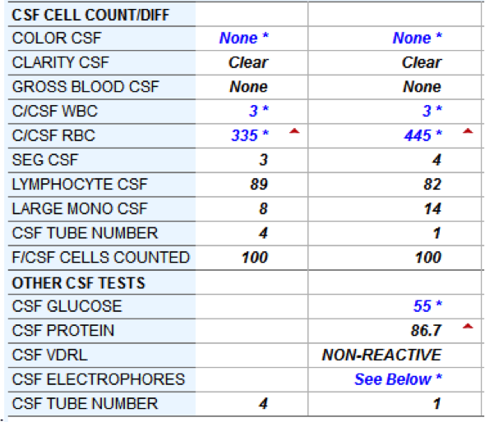
Hospital Days #4&5

Slide 11
Hospital Day #5
HSV-1 PCR may be negative early in disease
Clinical suspicion may warrant empiric therapy and repeat lumbar puncture

