Slide 1
2017 Match
Rush University Medical Center
Department of
Internal Medicine

Slide 2
2017-2018
Incoming
Internal Medicine
House Staff

Slide 3
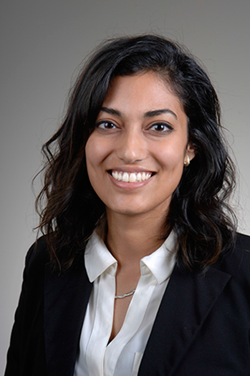
Nandini Abburi
Medical School:
University of Toledo
Undergraduate School:
University of Michigan
Fun Fact:
I auditioned at America's Got Talent in LA with my college dance team.

Slide 4
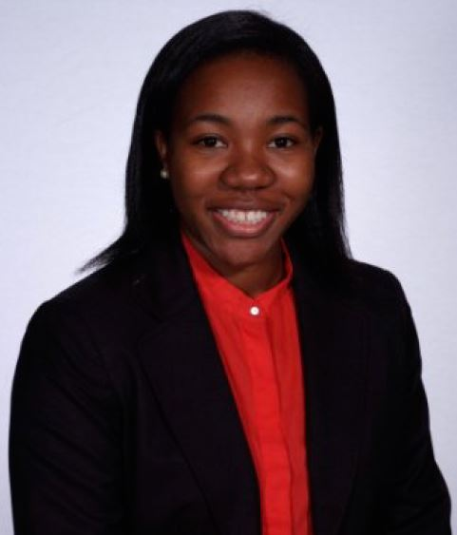
Audrey Bampoe
Medical School:
SUNY Downstate
Undergraduate School:
Cornell University
Fun Fact:
I live and breathe all things Mariah Carey.

Slide 5
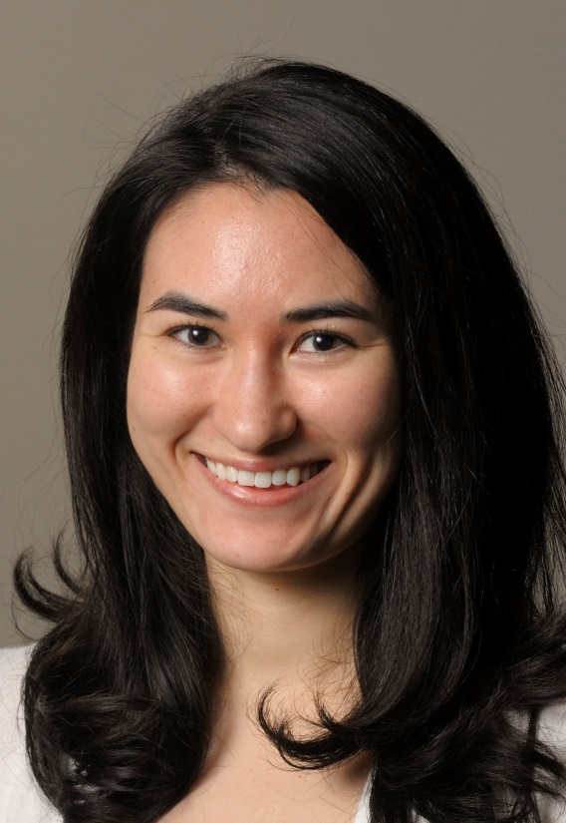
Adrienne Barry
Medical School:
University of Illinois – Chicago
Undergraduate School:
Emory University
Fun Fact:
I played violin in my local professional orchestra during medical school.

Slide 6
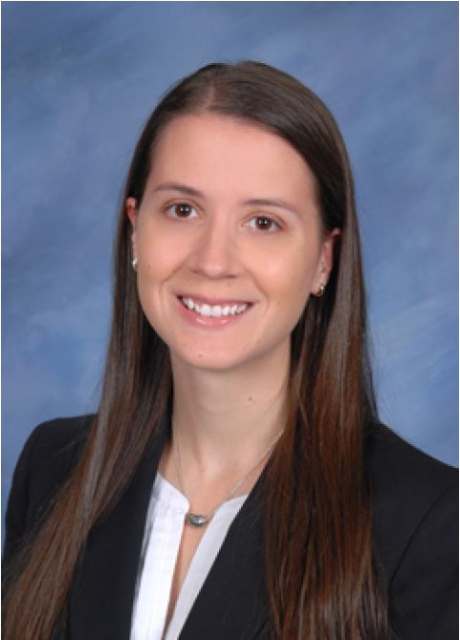
Mary Biglin
Medical School:
Wayne State University
Undergraduate School:
University of Michigan
Fun Fact:
I will (most likely) be running the Chicago Half Marathon in September!

Slide 7
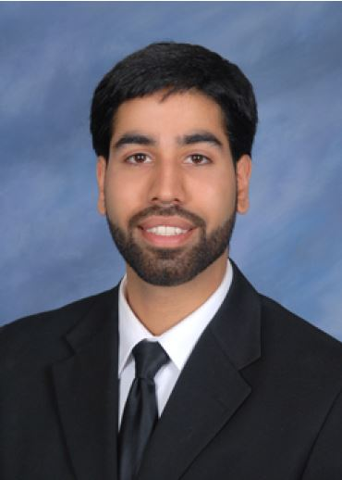
Vishal Birk
Medical School:
Wayne State University
Undergraduate School:
University of Western Ontario
Fun Fact:
I've competed in an official video game tournament, in which 3 of the top 10 players in the world were present.

Slide 8
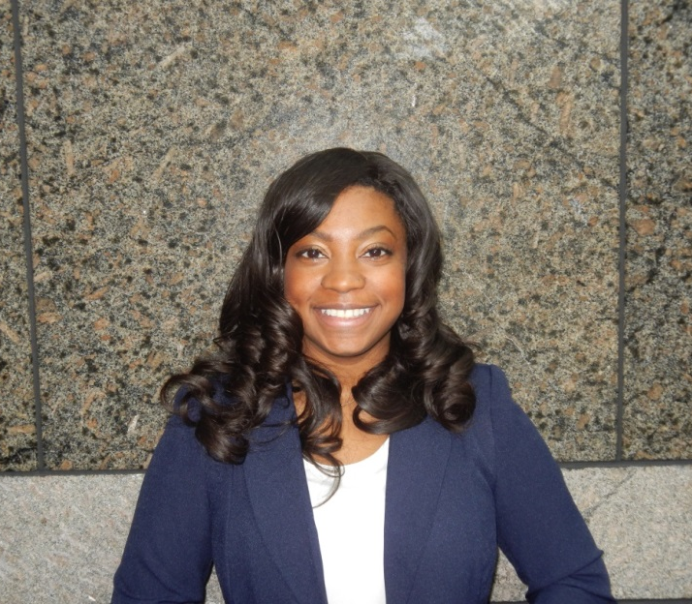
Cydney Bullock
Medical School:
University of North Carolina
Undergraduate School:
University of North Carolina
Fun Fact:
I don't like fruit, but I love vegetables.

Slide 9
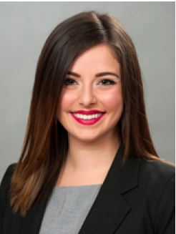
Sarah Carballo
Medical School:
Chicago Medical School
Undergraduate School:
Ripon College
Fun Fact:
Growing up, family vacations consisted of "camping" across the U.S. in the 40-foot family RV. I was also born at Rush and have officially come full circle!

Slide 10
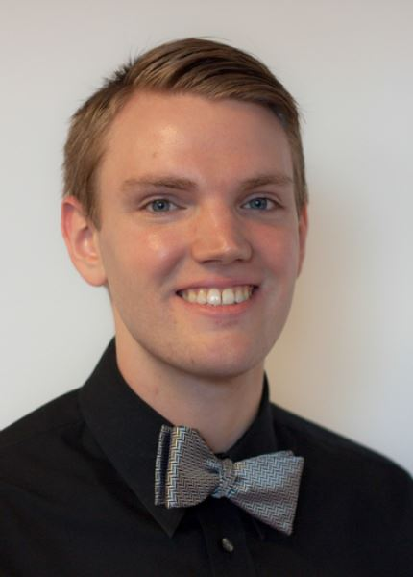
Mike Czapka
Medical School:
Albert Einstein College of Medicine
Undergraduate School:
Loyola University
Fun Fact:
Puns are my favorite – I’m currently working on a GomerBlog submission.

Slide 11
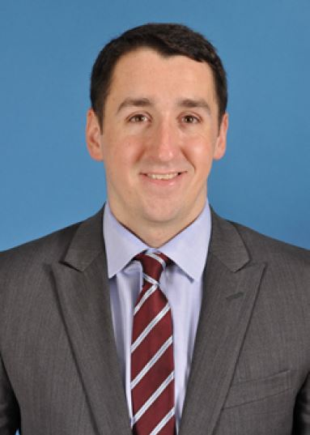
Patrick Duncan
Medical School:
University of Illinois - Peoria
Undergraduate School:
University of Notre Dame
Fun Fact:
I am the Class of 2017 U of I College of Medicine at Peoria ping pong champion.

Slide 12
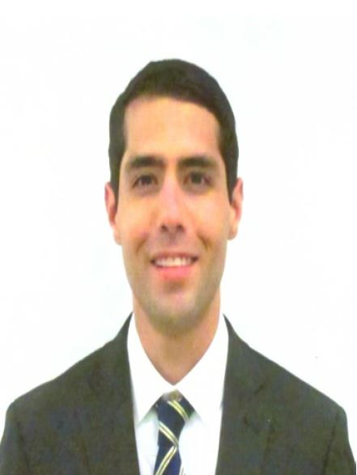
Mark Francis
Medical School:
University of Texas
Undergraduate School:
Oklahoma State University
Fun Fact:
In my free time, I'm an amateur radio enthusiast and licensed ham operator, call sign KG5NTI.

Slide 13
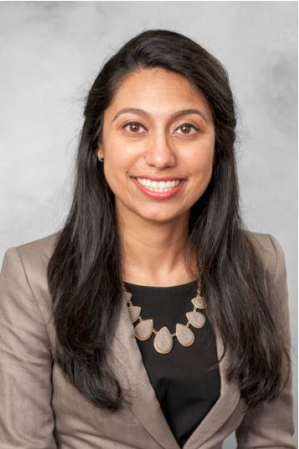
Shriya Gandhi
Medical School:
University of Illinois - Chicago
Undergraduate School:
University of Illinois -Chicago
Fun Fact:
I can speak, read, and write four languages.

Slide 14
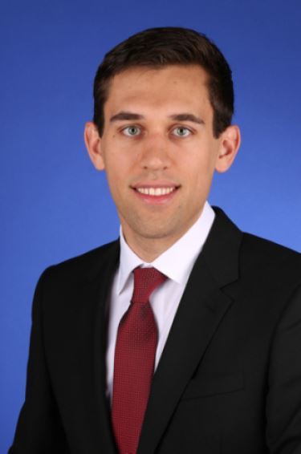
Michael Grant
Medical School:
University of South Alabama
Undergraduate School:
University of South Alabama
Fun Fact:
I have lived in all 4 U.S. time zones.

Slide 15
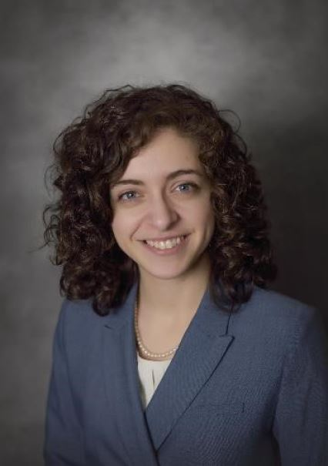
Heather Heiser
Medical School:
Michigan State University - Grand Rapids
Undergraduate School:
University of Michigan
Fun Fact:
I love hosting board game nights with my ever-expanding collection of fairly obscure board games!

Slide 16
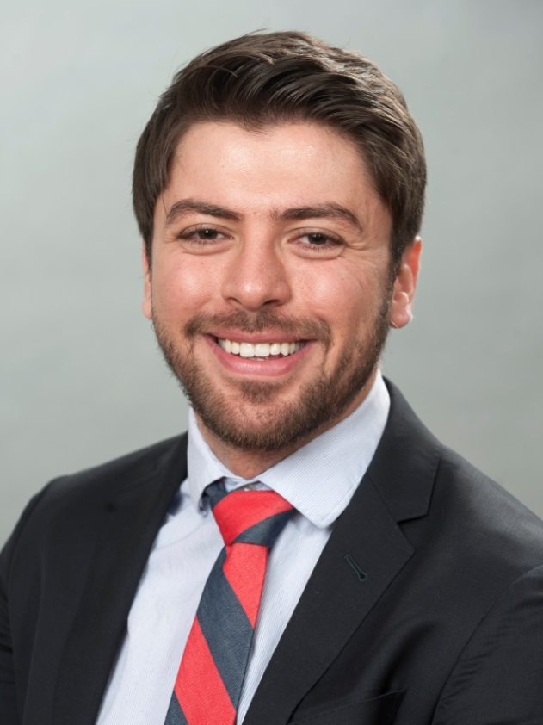
Mohamad Hemu
Medical School:
Chicago Medical School
Undergraduate School:
University of Denver
Fun Fact:
I was almost recruited to play soccer on a professional level while in Romania, but life had other plans!

Slide 17
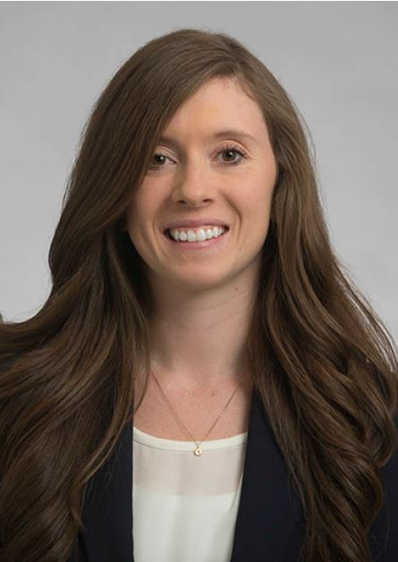
Kyrie Hungerford
Medical School:
Rush Medical College
Undergraduate School:
University of Michigan
Fun Fact:
My middle name is York, after the York Peppermint Patty.

Slide 18
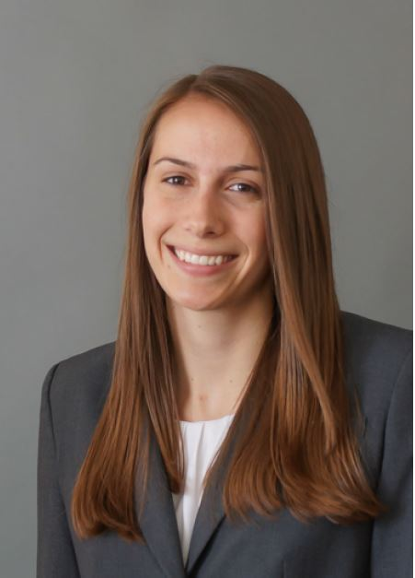
Melissa Kander
Medical School:
Ohio State University
Undergraduate School:
University of Notre Dame
Fun Fact:
One of my childhood swimming pictures was in a Gatorade commercial before the ESPYs last year.

Slide 19
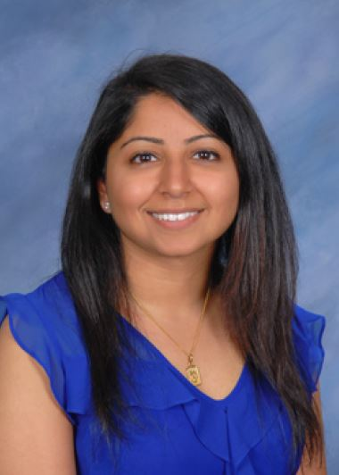
Navina Kapur
Medical School:
Wayne State University
Undergraduate School:
University of Michigan - Ann Arbor
Fun Fact:
I enjoy long outdoor runs.

Slide 20
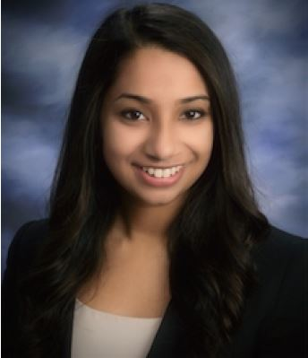
Revathi Kollipara
Medical School:
Indiana University
Undergraduate School:
University of Notre Dame
Fun Fact:
I enjoy choreographing and dancing to Bollywood songs.

Slide 21
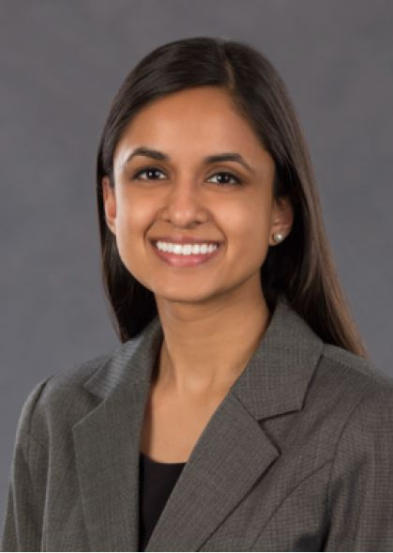
Sonya Kothadia
Medical School:
University of Miami
Undergraduate School:
Duke University
Fun Fact:
I once bungee jumped over the Nile River.

Slide 22

Kyaw Zaw Hein
Medical School:
University of Medicine Mandalay
Undergraduate School:
University of Medicine Mandalay
Fun Fact:
I am a photographer.

Slide 23
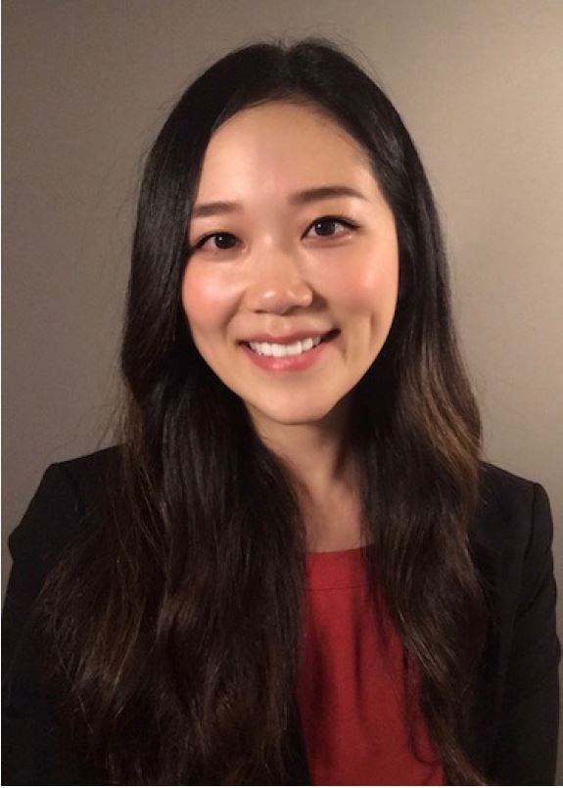
Josephine Lee
Medical School:
SUNY Upstate
Undergraduate School:
Cornell University
Fun Fact:
I have a chihuahua named Benji who knows a ton of tricks!

Slide 24
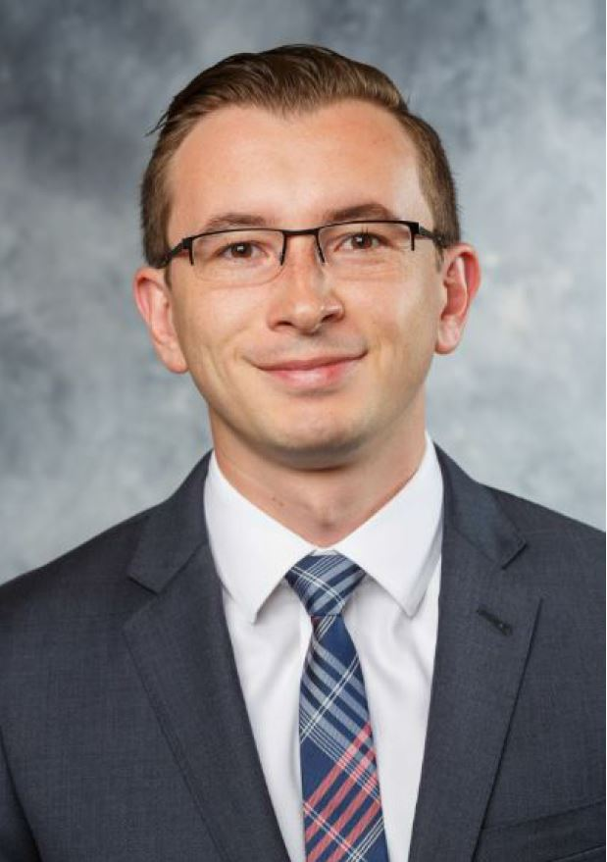
Vlad Manko
Medical School:
Ohio State University
Undergraduate School:
Northwestern University
Fun Fact:
My friends and I just finished a 13-mile Spartan Race in the spring.

Slide 25
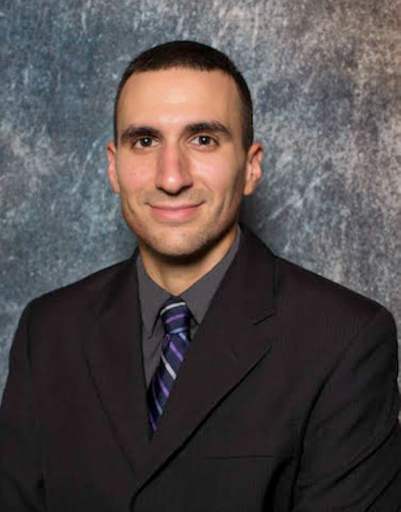
Abdel Marques
Medical School:
New York Medical College
Undergraduate School:
University of Florida
Fun Fact:
I've been dancing salsa since I was 12!

Slide 26
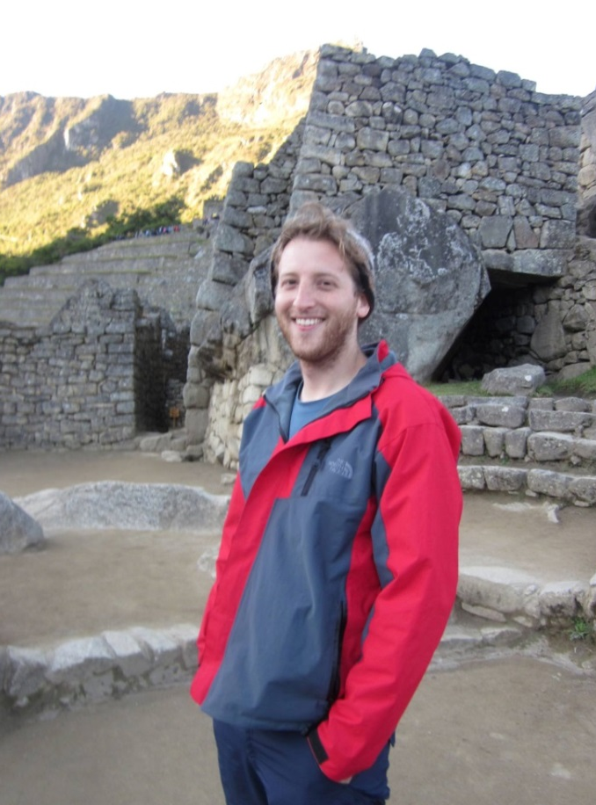
Sammy McGowan
Medical School:
Rush Medical College
Undergraduate School:
Brown University
Fun Fact:
I can juggle.

Slide 27
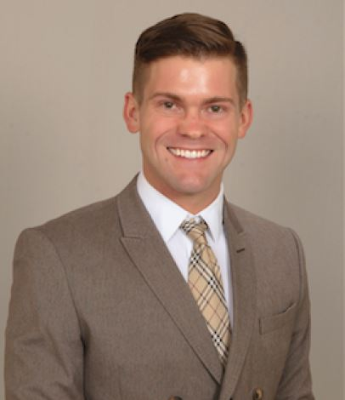
Andrew Moore
Medical School:
University of Tennessee
Undergraduate School:
University of TN at Martin
Fun Fact:
I was a piano performance major and worked as a pianist prior to medical school.

Slide 28
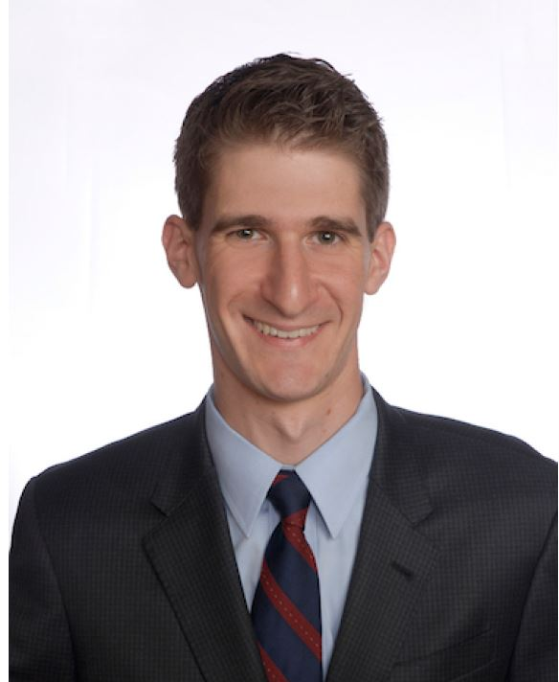
Matthew Nazarian
Medical School:
Thomas Jefferson University
Undergraduate School:
Tufts University
Fun Fact:
I do stand-up comedy.

Slide 29
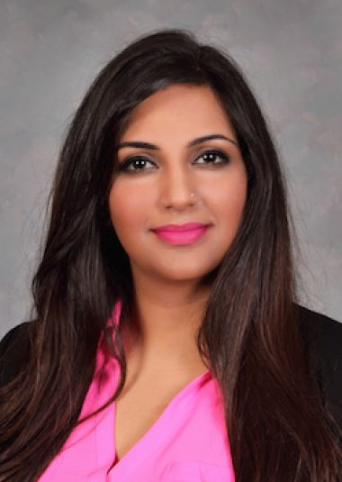
Nasha Nensey
Medical School:
Medical College of Wisconsin
Undergraduate School:
University of California - San Diego
Fun Fact:
Having never owned boots in California, I spent my first 2 snowfalls in Wisconsin in flip-flops. Needless to say, I have learned my lesson.

Slide 30
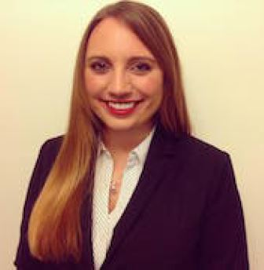
Courtney O’Brien
Medical School:
Nova Southeastern University
Undergraduate School:
Pennsylvania State University
Fun Fact:
I have traveled to South America on four separate occasions.

Slide 31
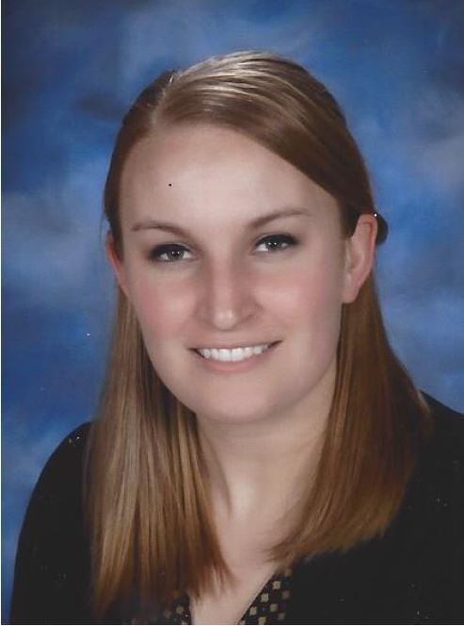
Allie Osen
Medical School:
Indiana University
Undergraduate School:
Bellarmine University
Fun Fact:
I enjoy a good trivia night!

Slide 32
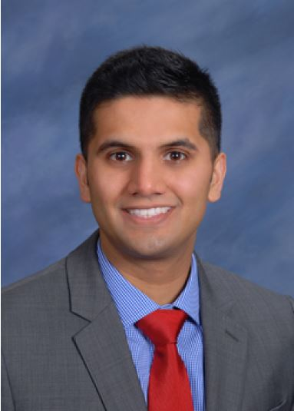
Keval Parikh
Medical School:
Oakland University
Undergraduate School:
University of Michigan
Fun Fact:
I'll be traveling to Croatia with my friends after graduation. I also love basketball and Taco Bell.
*He’s also Raj’s cousin! They both love Taco Bell…

Slide 33
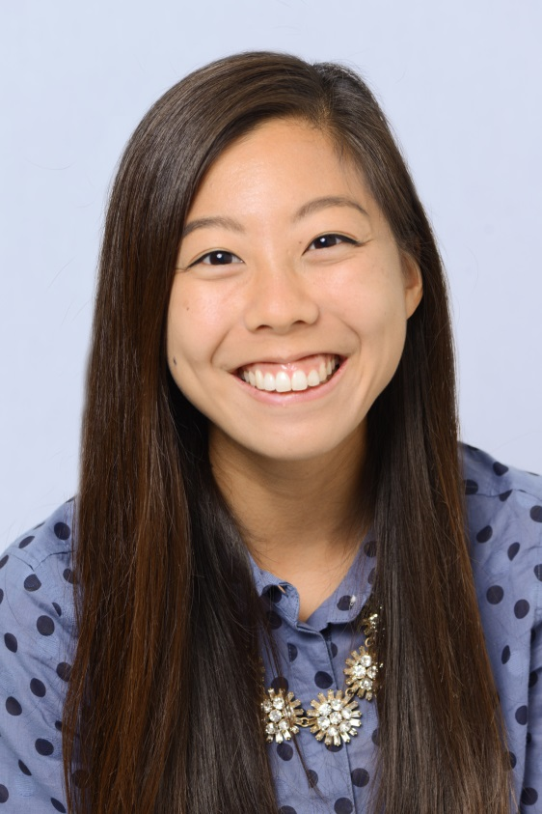
Erica Park
Medical School:
Indiana University
Undergraduate School:
Indiana University
Fun Fact:
I love to bake, and I post most of the recipes (along with some fun, random adventures) on my blog, Nommable.

Slide 34
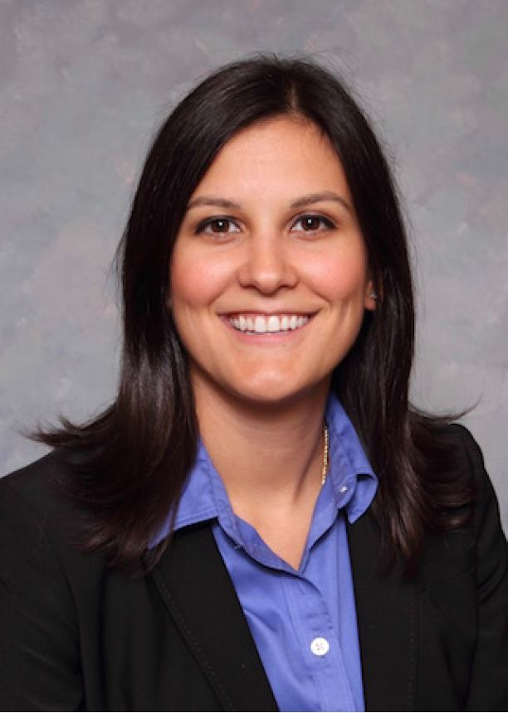
Mary Potkonjak
Medical School:
Medical College of Wisconsin
Undergraduate School:
University of Chicago
Fun Fact:
I was a collegiate pole vaulter.

Slide 35
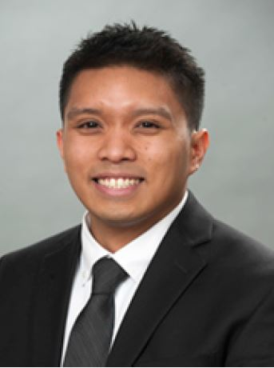
Carlo Prades
Medical School:
Chicago Medical School
Undergraduate School:
University of Illinois – Urbana
Fun Fact:
I love playing guitar and have written some original music as well.

Slide 36
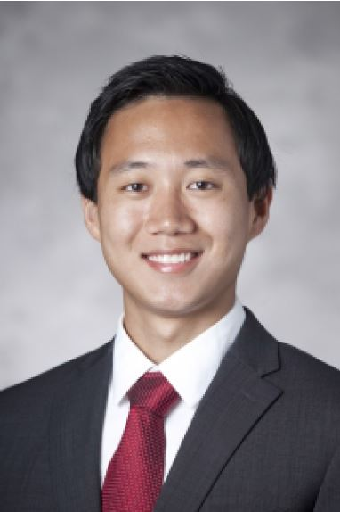
Sunny Qiu
Medical School:
Duke University
Undergraduate School:
Duke University
Fun Fact:
I was on the winning team of Duke’s graduate IM basketball league as an MS1.

Slide 37
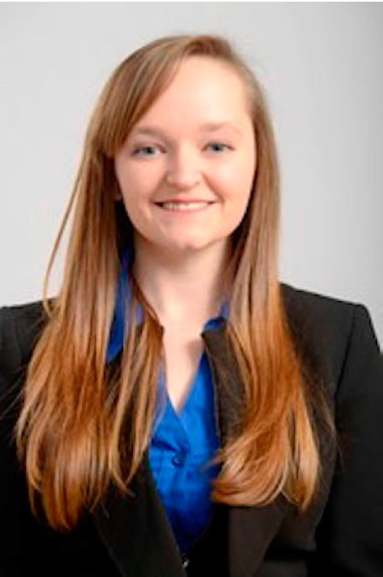
Megan Randall
Medical School:
Rush Medical College
Undergraduate School:
Wheaton College
Fun Fact:
In college I worked in a lab doing freshwater research, where I fed tiny shrimp to jelly fish under a microscope.

Slide 38
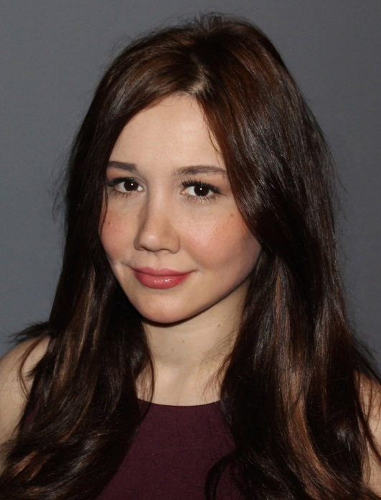
Aysel Renard
Medical School:
University of Illinois
Undergraduate School:
Loyola University
Fun Fact:
When I was a little girl growing up in Istanbul I was fascinated by tourists and their strange languages. In an effort to fool people into thinking I too was a tourist from a faraway land, I would also speak in a strange language, though mine was made up gibberish. Looking back I realize I probably wasn't fooling anyone, as six year olds don't generally vacation by themselves.

Slide 39
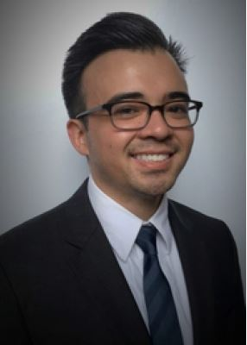
Andrew Rodriguez
Medical School:
Rush Medical College
Undergraduate School:
University of California - San Diego
Fun Fact:
I’ve won trivia night at Hawkeye's.

Slide 40
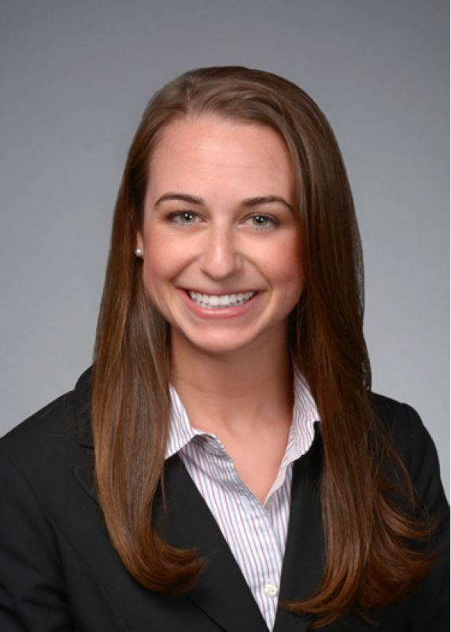
Allie Rzepczynski
Medical School:
Loyola University
Undergraduate School:
University of Notre Dame
Fun Fact:
I’ve been on the field of 19 college and professional football stadiums.

Slide 41

Nabila Sardar
Medical School:
Loyola University
Undergraduate School:
University of Southern California
Fun Fact:
Growing up, my family had over 10 different animals as pets (sugar glider, chameleon, macaw, python included).

Slide 42
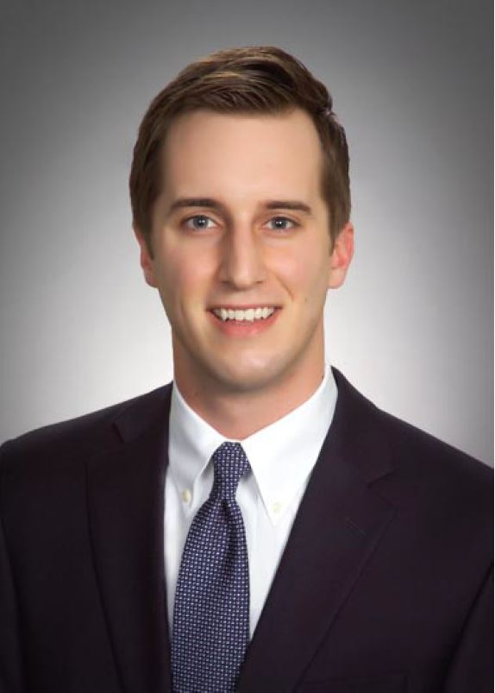
Steve Sawyer, Jr.
Medical School:
Creighton University
Undergraduate School:
Creighton University
Fun Fact:
I enjoy backpacking and recently went on a trip to Havasu Falls in the Grand Canyon.

Slide 43
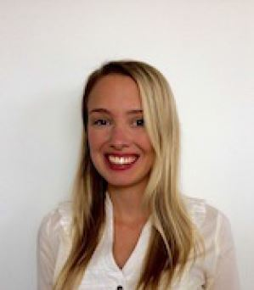
Mica Schachter
Medical School:
Instituto Universitario Italiano de Rosario
Fun Fact:
I am addicted to cheese, shoes and classic rock!

Slide 44
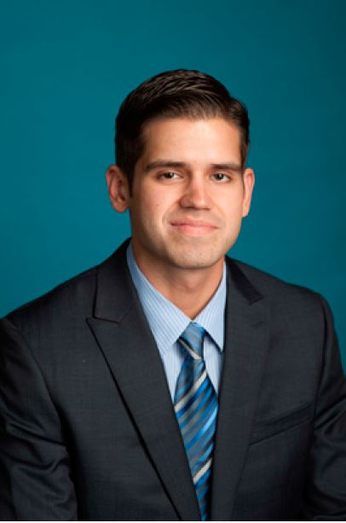
Jordan Scharping
Medical School:
Virginia Tech
Undergraduate School:
UCLA
Fun Fact:
When I was a kid, I went to a basketball camp led by Michael Jordan, called "Michael Jordan Flight School."

Slide 45
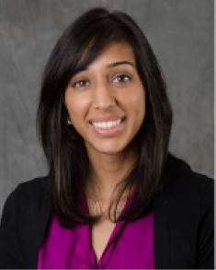
Rupal Shastri
Medical School:
Michigan State University - Flint
Undergraduate School:
University of Michigan
Fun Fact:
I clog danced in high school!

Slide 46
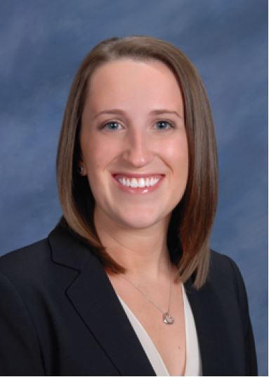
Lauren Singer
Medical School:
Oakland University
Undergraduate School:
Vanderbilt University
Fun Fact:
I was a competitive figure skater for many years and I've skated in shows with several Olympians.

Slide 47

David Smyth
Medical School:
University of Utah
Undergraduate School:
University of Utah
Fun Fact:
I enjoy refinishing and reupholstering midcentury modern furniture in my free time.

Slide 48
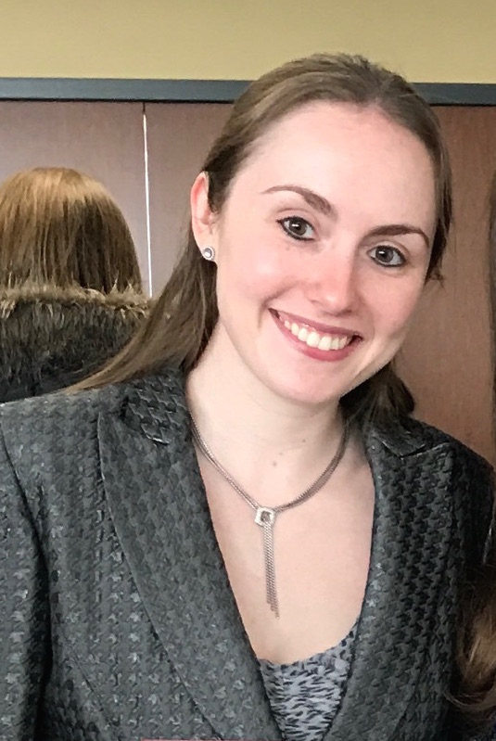
Andrea Sterenstein
Medical School:
Chicago Medical School
Undergraduate School:
Case Western Reserve University
Fun Fact:
I completed the Disney Princess 1/2 marathon in Disney World with my mom just before starting medical school.

Slide 49
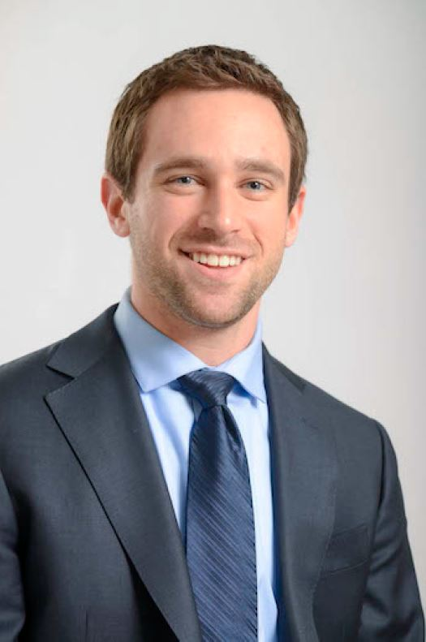
David Walker
Medical School:
Rush Medical College
Undergraduate School:
Carleton College
Fun Fact:
During my gap year before medical school, I studied Great White Sharks in Mossel Bay, South Africa as part of a research internship.

Slide 50
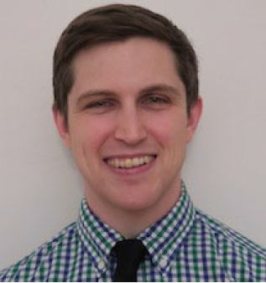
Conor Walsh
Medical School:
Tufts University
Undergraduate School:
Bowdoin College
Fun Fact:
I recently got married in India!

Slide 51
Thank You
Attending Staff

