Slide 1
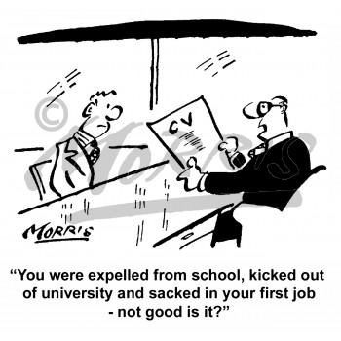
What your CV says about you
Susan Chubinskaya, PhD
Associate Provost, Faculty Affairs
Updated on August, 2016

Slide 2
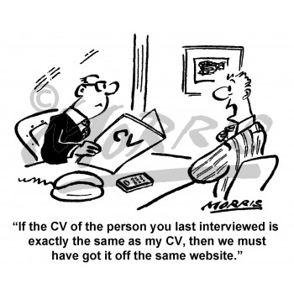
What is so important about my CV???
It is your introduction to a new person, job, organization
And as they say, you only get one chance to make a good first impression
So today we are going to talk about your “ContinuouslyupdatedCV”

Slide 3
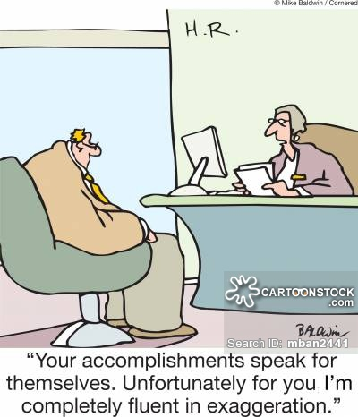
How to Prepare an Effective CV
Curriculum Vitae
Course, path of life
Curriculum Vitae = The path of one’s life
The CV is a snapshot of the individual’s entire professional life, and therefore, should accurately reflect all major activities relevant to the profession, throughout the individual’s career. This includes everything, from prior faculty appointments, to committees and assorted responsibilities. Inaccuracies jeopardize credibility!!!

Slide 4
CV
Differs depending on the sector you are in and the
position to which you aspire
Thus, purpose and audience are guides
Clarity, accuracy, relevancy are critical
Sections clearly defined, information provided in reverse chronology including publications and presentations
Your name highlighted
Can use words like “recent” - “selected” or “relevant” (for special purpose CV only)

Slide 5
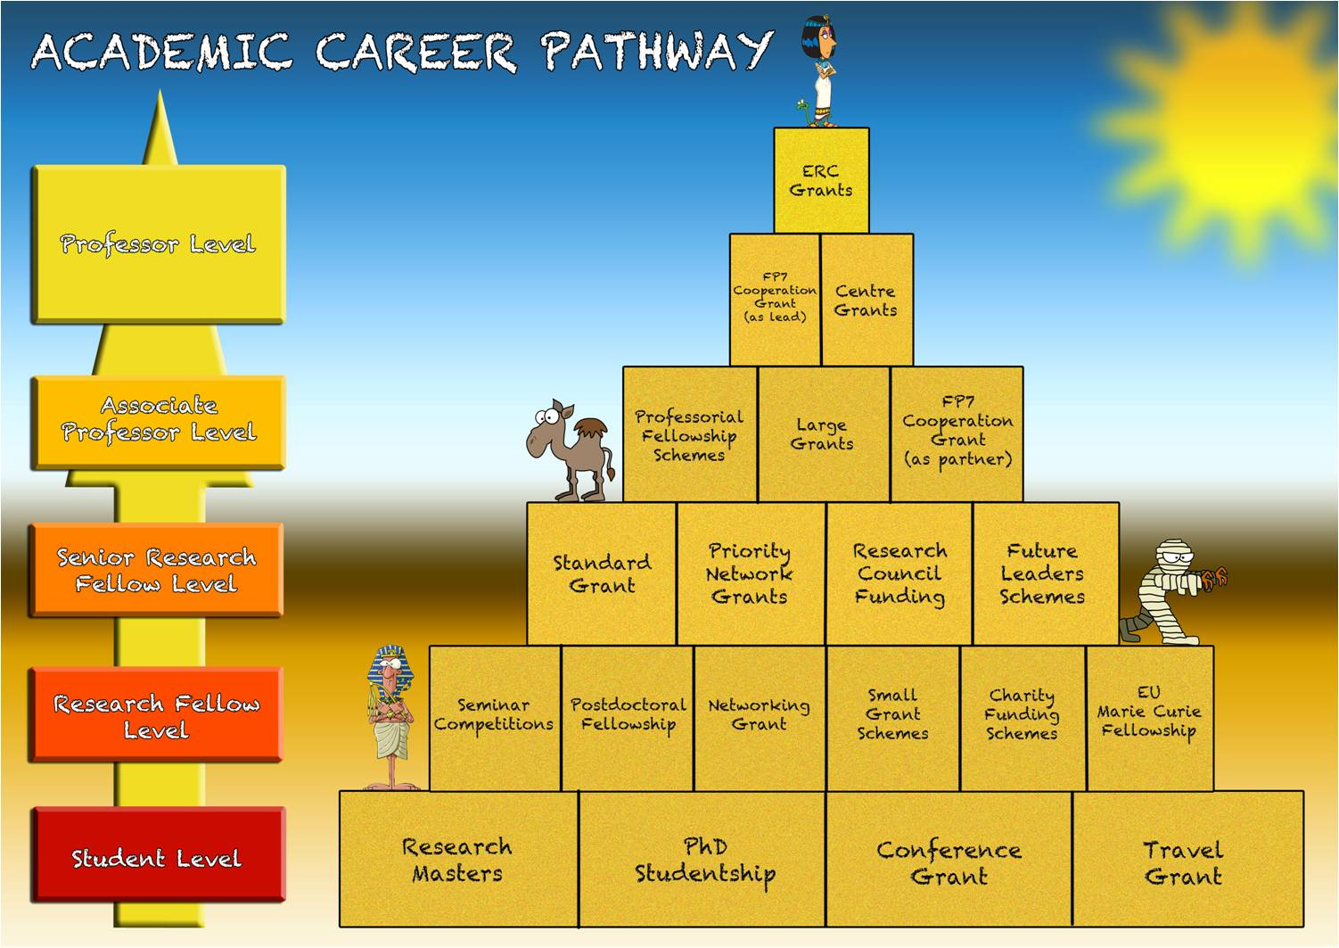
Curriculum Vitae
Must include:
Education and training
Faculty, hospital, other professional appointments
Honors/Awards
Service (includes all types, e.g., university, clinical, leadership, professional, and scholarly service)
Teaching/Education (be sure to include mentoring/advising)
Scholarly activity
  Grants, contracts, and awards
  Other funding
  Publications
  Abstracts
  Presentations – even if you were not the one presenting

Slide 6
Areas of Excellence
That’s how it is at Rush
  Education
  Research
  Clinical excellence
  Service
    Administrative
    Leadership
    Community
    Global, etc
Education/Teaching and Research/Scholarly activities are critical to the mission of the majority of Institutions that have tenure!!!

Slide 7
Scholarly Productivity
Activity in professional societies: elected positions
Elections to prestigious scientific societies via peer-review process
Appointments as editor, reviewer, and referee
Consulting activity
Research funding (if applicable)
Patents, procedures and methods
Publications – peer-reviewed articles & book chapters, peer-reviewed abstracts
    Your contribution, significance of work and publication impact factor
Presentation of scholarly papers: invited, keynote, podium, posters at international, national, and regional conferences/symposiums, seminars
Extramural review courses: taught, directed, developed
Note regarding electronic publishing:
Burden of demonstrating quality and significance (judged by some criteria) is on you

Slide 8
Publications
Complete citations by category
  Peer-reviewed publications
    Reports of Original Work
    Case reports
    Review Articles
  Editorial/Commentaries
  Letters to the Editor
  Book Authorships, Editorships, and chapters
  Published Abstracts (must have a reference that can be looked up)
  Non-peer-reviewed publications
  Other (please specify)
Indicate level of participation if multiple authors
Include articles “in press”
DO NOT include articles “to be submitted” or “in preparation”
Number each entry

Slide 9
Presentations
List separately
Podium presentations
Poster presentations/Exhibits
Other (e.g. videos)
Invited lectures/presentations
International
National
Regional
Local
University

Slide 10
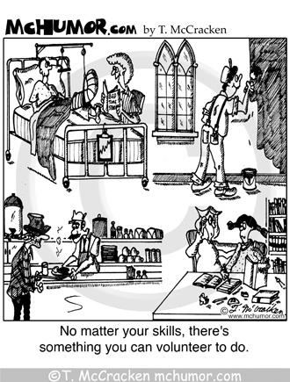
Service
Activities not directly related to teaching, research, or patient care…
You know what it is when you see it!
Examples:
Leadership
Management
Committees
Task forces
Lay education
Community incl. Global health
Prof. organizations
Faculty Service

Slide 11
CV Tips
Dates in a separate column – to the right
List items in reverse chronology within each category
Format the pages for easy reading
Emphasize/format new sections consistently
Add sections if some activities do not fall into the standard ones
  As long as they are clear, no problem!
    The committees will never penalize you for providing MORE information!!!)

Slide 12
More CV Tips
Number the pages
Number all long lists of items
Highlight your name (bold, underline)- the reader will “find” you immediately, especially when there are multiple authors
Annotate all papers and grants: if you played a major role in it, but this is not immediately obvious (you are not 1st or Sr. author, or not the PI), the annotations explaining your contribution to the work will get you more credit for it!

Slide 13
And even more CV writing tips…
Should contain accurate information; dates should be as accurate as possible
Should be up-to-date
Represent the style of the institution
Consistent in info, style, font, arrangements, readable
Clear; explain abbreviations
Good formatting and presentation are essential
Avoid typos!

Slide 14
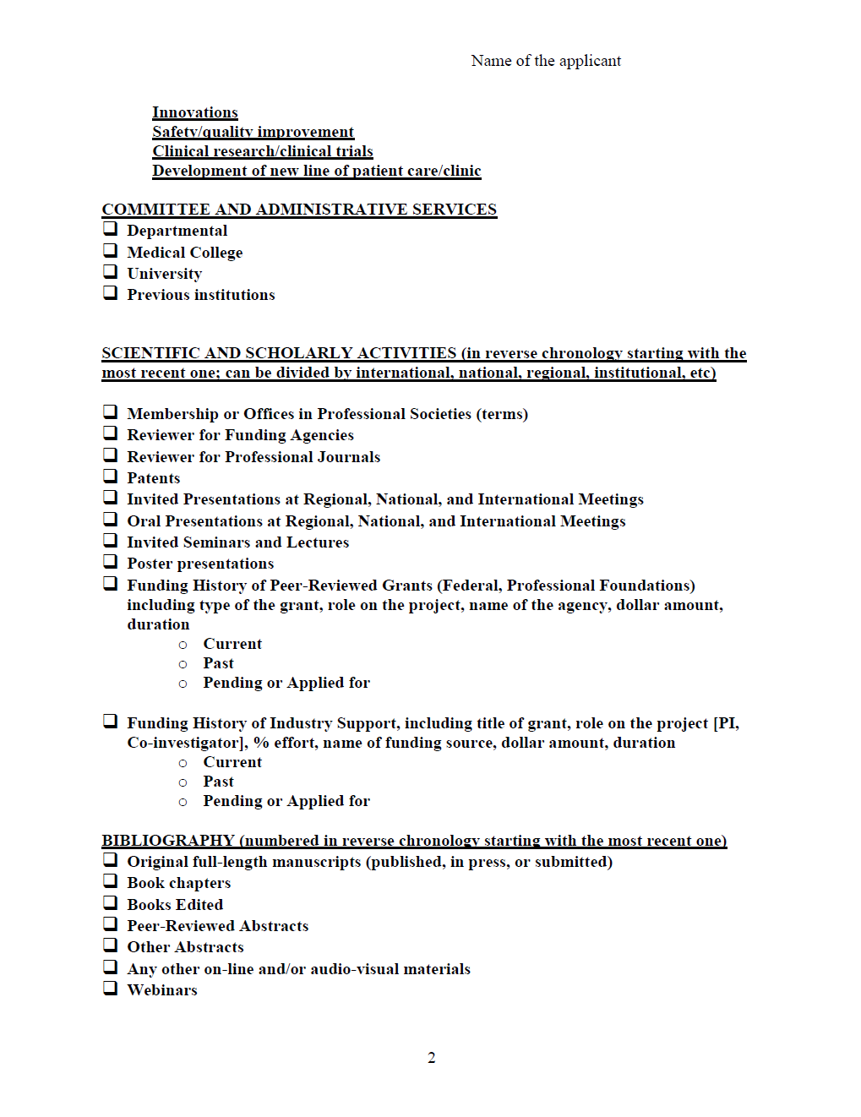
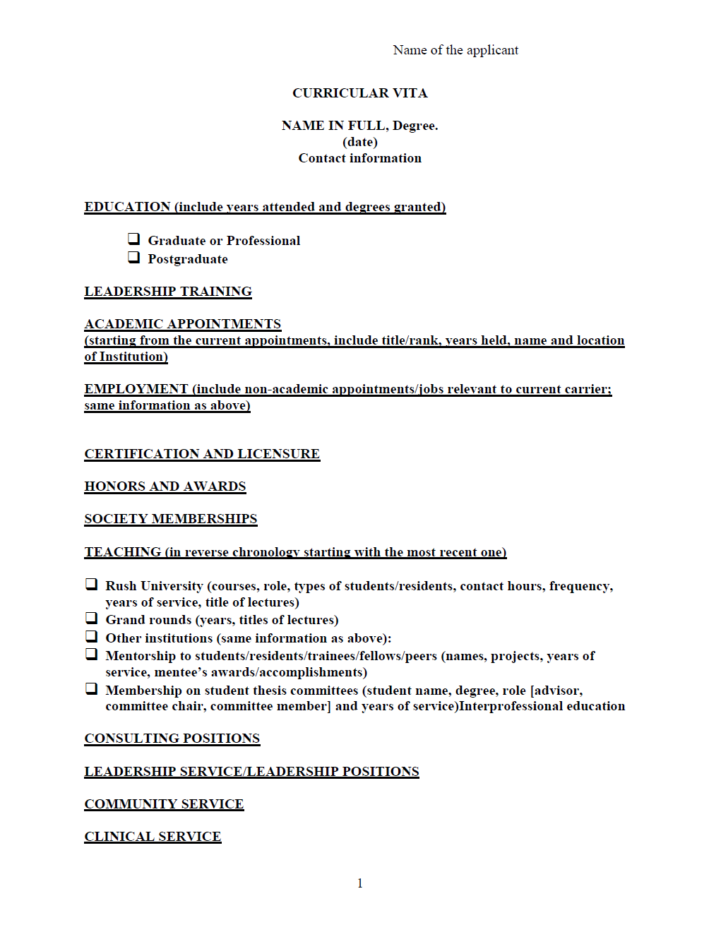


Slide 15
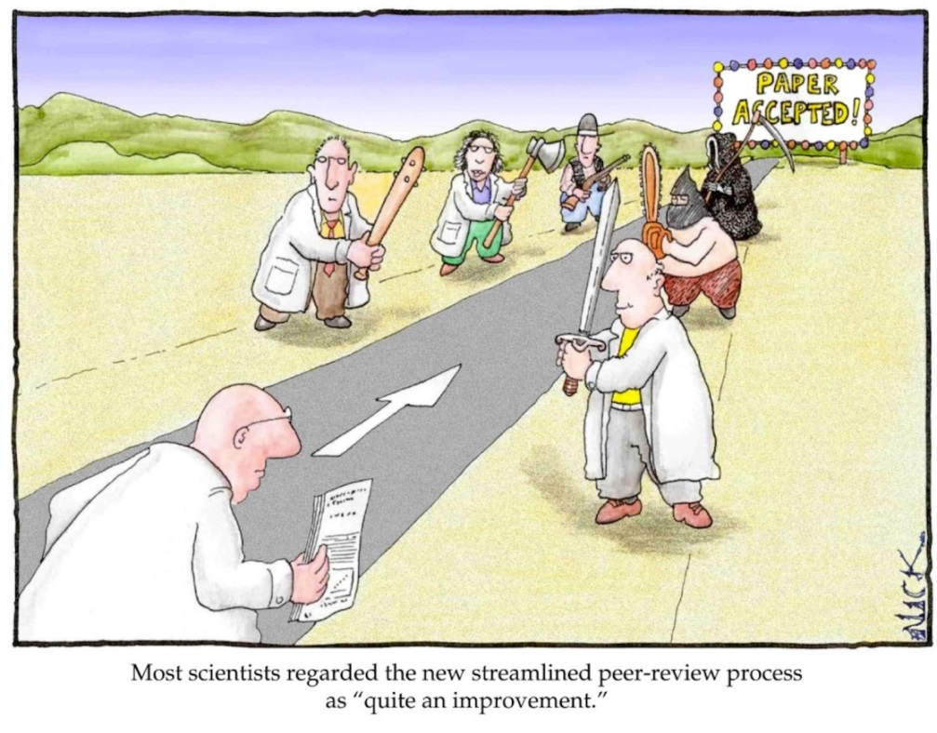
Bottom Line
Provide as much and detailed information as possible…
You will save the committee from:
  Guessing
  Make their work easier, and
  They will be happy with you
  Trust me…
  YOU WANT THEM TO BE HAPPY AND HAVE LESS WORK!!!

Slide 16
Bottom Line
Provide as much and detailed information as possible…
You will save the committee from:
  Guessing
  Make their work easier, and
  They will be happy with you
  Trust me…
  YOU WANT THEM TO BE HAPPY AND HAVE LESS WORK!!!
ORS 2016 PAS CV

