Slide 1
New COSFAP Policies and Procedures Key changes
Susan Chubinskaya, PhD
Associate Provost for
Faculty Affairs

Slide 2
Disclosures
The speakers have indicated that they have no potential or actual conflict of interest in regards to this presentation.
The Course Planning Committee indicates no actual or potential conflicts of interest in regards to this presentation.
This presentation was created without any commercial support.

Slide 3
To obtain credit you must:
Be present for the entire session
Complete an evaluation form
Return the evaluation form to staff
Certificate will be sent to you by e-mail.
This course is eligible for 1 (one) AMA PRA Category 1 Credit™
Accreditation and Designation Statement: Rush University Medical Center is accredited by the Accreditation Council for Continuing Medical Education to provide continuing medical education for physicians. Rush University Medical Center designates this live activity for a maximum of 1 AMA PRA Category 1 Credit(s)TM Physicians should claim only credit commensurate with the extent of their participation in the activity.
Rush University is accredited as a provider of continuing nursing education by the American Nurses Credentialing Center's Commission on Accreditation. Rush University designates this live/internet enduring material activity for (1) Continuing Education credit(s).
This activity is being presented without bias and without commercial support.

Slide 4
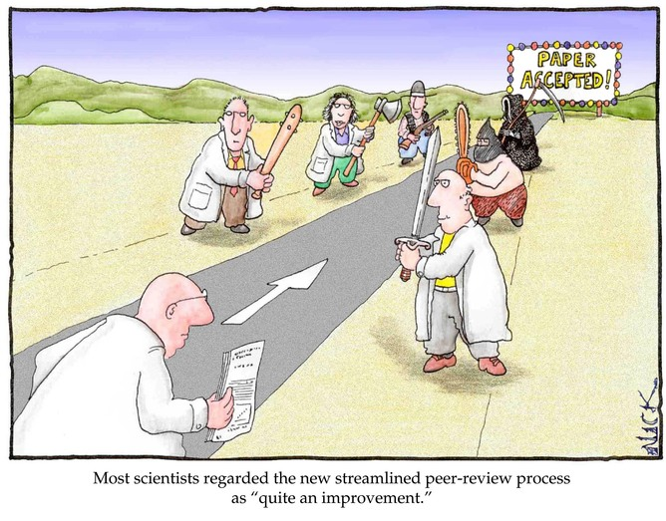
Info about COSFAP
RMC
Meetings every 4th Wednesday of the month @ 8-9am
CV template and COSFAP policies and guidelines @ Academic Affairs: www.rushu.rush.edu/academicaffairs
Queries: Susan Chubinskaya susanna_chubinskaya@rush.edu; 26306
or COSFAP Chair (Dr. Vijaya Reddy) or Secretary (Dr. Deb Selip)
Medical Staff Office: packets submission

Slide 5
COSFAP Function
Promotions are not granted simply as a consequence of time in service
Does not review Junior rank appointments
Review of nominations from department Chairs for appointment or promotion of an individual to senior faculty rank
Associate Professor
Professor
Upon COSFAP approval all new appointments and promotions will be approved by the Dean, Faculty Council/Provost.

Slide 6
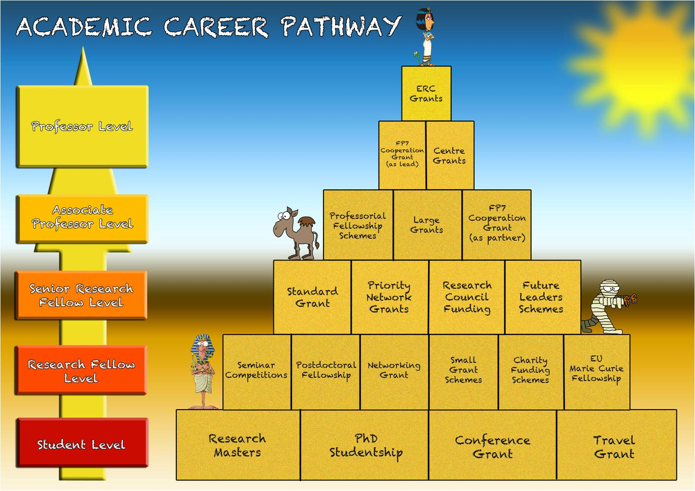
Faculty Tracks: RMC
Single track, but multiple paths

Slide 7
Appointment to Senior Faculty Rank
Appointments to senior faculty rank at other institutions may be considered in assessing a proposed faculty appointment, but will not be the sole determinant in recommending a specific faculty rank.
All requirements for appointments with regard to packet preparation are the same as for promotion

Slide 8
Timeline of the process
Professor
Minimum 5 years
Associate Professor
Minimum 5 years
Package submission Med Staff Office
COSFAP Review & Approval
initiation
Faculty Council Review & Approval
Solicitation of letters
Approval by the Dean
Assistant Professor
0
5y<
1 2 3 4 5 6 7
month
Work towards next step
Notes:
Initiation is when you start to assemble the package, not start thinking about the promotion

Slide 9
Why Change?
Changed Reality of Acad. Medicine
Faculty Dissatisfaction
Diversity of Faculty Activities
New P&T Guidelines
Patient-centered
Focus on quality and safety
Multidisciplinary Team-based
RVUs/Clinical productivity
Change in reimbursement
Population studies
Multi-centered studies
Multiple PIs
Centers/Institutes
AAMC: GFA, FF, etc.
Consistency of criteria
Path for clinicians was not well-defined
Change in educational approach
Institutional Leadership
IPE
Multidisciplinary research and patient care
Leadership
Service: community, global
Hospital-based projects
Professional societies
Mentorship

Slide 10
Areas of Excellence/Changes
Old
Teaching Excellence
Research/Scholarly
Clinical Service
Administrative Service
New
Education
Research
Clinical excellence
Service
Administrative
Leadership
Community
Global, etc
New: All candidates for senior faculty promotion, regardless of the combination of criteria chosen for one’s promotion/appointment, are expected to demonstrate evidence of scholarly productivity

Slide 11
Scholarship
Education – Research – Clinical - Service
Publish
Present
Professional societies
Participation
Research Endeavour
scholarship

Slide 12
Scholarly Activity
Defined as:
Synthesis of knowledge and the accompanying dedicated effort(s) to convey this knowledge to the local, regional, national, and/or international community.
Scholarly activity does NOT necessitate production of original research or research projects.
However, it does require the dissemination of synthesized ideas in a thoughtful and uniform approach both within Rush and beyond.
Expectation
at least ONE of a candidate’s scholarly work products/achievements is in the form of the written word:
peer reviewed publications
peer reviewed abstracts
book chapters
white papers
position statements
online educational modules
institutional guidelines and/or protocols
quality improvement protocols
safety guidelines, etc.…).
Details are on pp: 13-14

Slide 13
Examples of scholarly activity
Publications in the general area of education, research, clinical excellence, and service
Editorship of books and other educ. materials (e.g. books, chapters, reviews, non-peered reviewed articles, editorials, etc.)
Invited presentations in scientific or med. acad. symposia, meetings, and lectures at the regional, national or international level (course creation, symposia organization, meeting oversight and synthesis, etc.)
Participation and leadership on health care quality, safety, and outcomes projects and initiatives (institutional, local, regional, national, international)
Participation and leadership on public health and community projects and initiatives (institutional, local, regional, national, international)
Participation and leadership on health care information technology creation, integration, and problem solving (i.e. software, hardware, electronic medical records, etc)
Participation and leadership on health care education
Participation and leadership in health care strategy and policy affecting institutional, local, regional, national and/or international forums

Slide 14
Examples of scholarly activity (cont)
Presentations at regional, national or international prof. meetings, courses or seminars. There should be evidence of first or senior authored presentations in this area or explanation of the contributions in the multidisciplinary work.
Participation in the peer review process by membership on institutional, regional, national or international scientific review boards (e.g. NIH study sections, DoD or NSF panels, foundation/funding agency review boards, etc), or review of scientific manuscripts for professional journals
Membership on editorial boards of scientific or healthcare professional journals
Media interviews
Production of guidelines, policies, procedures for institutions, government agencies, health care/research societies, etc.
Participation and leadership in health care economics and business modeling affecting institutional, local, regional, national and/or international forums
Extramural review courses taught, directed or developed and the organization of regional, national or international conferences
Election to prestigious scientific societies via peer review process
Election to an org. post or office in a prof. society which requires service to the prof. society

Slide 15
Associate professor
Old
Advanced graduate degree
Hold the title of assistant professor for a min of 5 yrs
One of the TWO areas of excellence should be teaching and/or research/scholarly
Potential for leadership and achievement of at least local or regional recognition in chosen areas of expertise
New
Advanced doctoral graduate degree
Hold the title of assistant professor for a min of 5 yrs
Superior performance, continued productivity, and superior performance in at least TWO areas:
Education
Research
Clinical excellence
Service
Potential for leadership and achievement of at least regional recognition in chosen areas of expertise
Professionalism/ICARE values

Slide 16


Professor
New
Advanced doctoral graduate degree
Hold the title of associate professor for a min of 5 yrs
Superior performance in at least THREE areas:
Education
Research
Clinical excellence
Service
Evidence of proven Management and Leadership
National/international recognition
Professionalism/ICARE values
Old
Advanced graduate degree
Hold the title of associate professor for a min of 5 yrs
Superior performance in TWO areas of excellence: teaching and research/scholarly
Demonstrated administrative excellence/leadership
National/international recognition

Slide 17

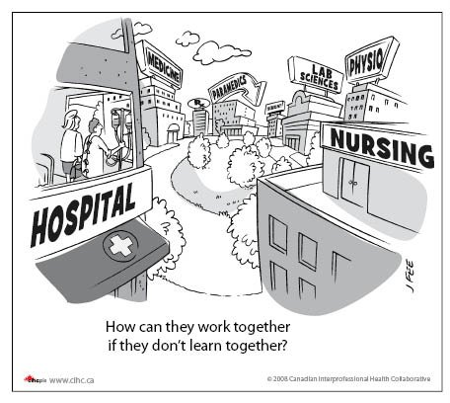

Promotion Criteria Teaching/Education
INNOVATIONS
Mentoring
Courses/ Clerkships/ residencies/ CME Programs
Instruction
Awards
Development/ Directorship
Scholarly Work
Educational Materials/ Online resources
Interprofessional Education
Alignment-
Goals to institution
Notes:
This transition displays the innovations on the same slide as the general criteria; should all the innovations be labeled? Are further details required?
Innovation: IPE & Mentoring/Archie provide specifics and details
Scholarly work
Faculty goals are aligned with the department and institution
Forever mentoring

Slide 18

Education
Evaluated based on:
Quality
Quantity
Innovation
Creativity
Evidence of leadership in education
Scholarly work is required!
Documentation:
Quantitative
Qualitative
Demonstrated impact
Derived work product

Slide 19
Examples of educational excellence
Creation of educational exercise(s) that serve(s) as a model for other institutions
Teaching via classroom didactics/lectures/educational sessions/medical rounds/simulation courses/bedside teaching
Development/directorship of programs, courses, classes, or clerkships
Mentorship: students/residents/fellows/trainees/peers
Educational awards
Visiting professorships at other academic institutions
Invitation for educational lectureships/workshops
Scholarly work in textbooks, review monographs, or reviews published in peer review journals re: educational work or educational research
Development and/or execution of web based educational forums
Publication of original papers in peer review journals re: education
Development of novel educational resources
Outline of achievements of former trainees and mentees
Membership in national, international, or inter-institutional educational activities and educational societies
Interprofessional education of students, trainees, mentees, or peers through course work, seminars, professional society meetings, lectures, etc.
Original educational research supported by intramural or extramural funding

Slide 20

Examples of research excellence
Demonstration of proven record of creative, high quality, significant work
Independence of research accomplishments
Extramural funding to support independent research activities
Patent and/or development of new or novel technology.
Evidence of mentorship of trainees (students, residents, colleagues, post-doctoral students) and the types of projects, activities, research projects in which mentoring occurred.
Lectures and presentations to educate students, colleagues, peers, etc. on one’s research endeavors

Slide 21
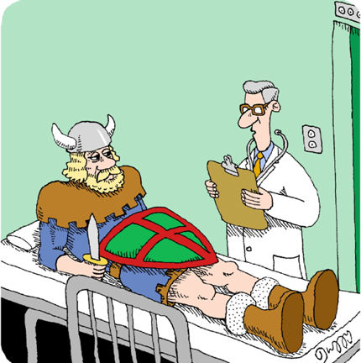

Examples of Clinical Excellence
Faculty who are put forth for promotion under clinical excellence will be evaluated on the QUALITY and IMPACT of their clinical service and its accompanying CONTRIBUTIONS to advance health care quality, delivery, safety, and outcomes.
Quality care
• Beneficial Care
• Patient Centered Care
• Efficient Care
• Timely Care
• Safe Care
• Equitable Care

Slide 22
Clinical Excellence (Cont)
Participation in Leadership projects
Decrease infection rates
Decrease readmission rates
Improve family centered care
Improve through-put
Improve resource utilization
Decrease expenditures while improving care
Improve patient satisfaction
Improve discharge processes
Facilitate timely care
Improve provider/patient communication
Improve follow-up rates
Improve patient compliance
Improve clinical treatment success rates
Diminish adverse patient care events
Improve community engagement and outpatient management of patients and/or their families
Safely integrate technology into health care via IT, Electronic Medical Records, patient monitoring systems, etc.
Introduce, apply, or evaluate new or existing clinical devices, procedures, and/or treatments that may improve patient care and/or outcomes
Develop and/or implement new or unique patient care models in the inpatient units and/or outpatient clinics that significantly impact quality care and/or outcomes
Deliver clinical work in the community or globally (free clinics, charity care, international health) that impacts community engagement, care, etc.
Facilitate and/or create organized and thoughtful approaches to interdisciplinary / multidisciplinary care among providers to improve upon and provide quality care and outcomes

Slide 23


Leadership
Management
Committees
Task Forces
Community Outreach
Professional Organizations
Faculty Service
How may we be of Service?
Global Health
Did I leave a mark?
Notes:
The magnifying is to suggest impact. (it can go or stay). Does this slide require more? Are the animations alright? (Include Global service; service to whom: institution, profession, community, impacts )

Slide 24
Examples of excellence in service
Leadership in planning and/or developing programs and policy at RMC, RU, RUMC
Leadership in planning and/or developing critical strategy and/or infrastructure (divisions, departments, sections, care units, etc) essential to the growth and success of RMC, RU, RUMC
Leadership and management in the above activities (a) and (b) at other medical colleges, universities, medical/professional societies, journals, governments, etc. that establish repute for senior faculty in the regional, national, and international community
Community Service / Community Health Care/ Global Health Care through creation of community health clinics and /or educational outreach to at risk patient populations
Election to clinical societies or offices in health care, health policy, and/or biomedical journals, organizations, and societies
Active membership on regional or national clinical advisory boards or committees
Active membership on Rush Medical College and Medical Staff committees.
Course directorships and other administrative responsibilities for activities within the Medical Center or the Rush System for Health that support the academic mission of the Institution
Evidence of successful entrepreneurship

Slide 25
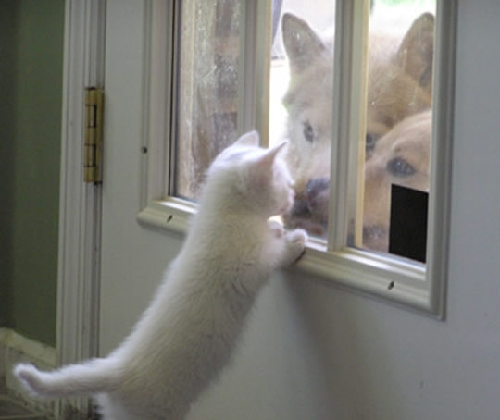
Questions?

